Slide 1
Sustainable & Smart Tourism
Training Program
Organized by Mekong Institute (MI)
Funded by Mekong – Korea Cooperation Fund (MKCF)
November 2023

Slide 2



Sustainable Tourism Governance & Strategic Planning
MODULE 3
Trainer
November 2023

Slide 3
Introducing Sustainable Tourism Governance (1)
Session 1
Monday

Slide 4
Introduction to Governance
Local & Regional Governance Models
Identifying key Stakeholders
Stakeholder Engagement Strategies

Slide 5


Introduction to Governance & Tourism
Structures of governance schemes and tourism.
Geographical aspects. DESTINATION
Governance takes a systematic approach to reveal the varying internal and external dynamics that influence tourism policy and strategy across regions and countries.

Slide 6

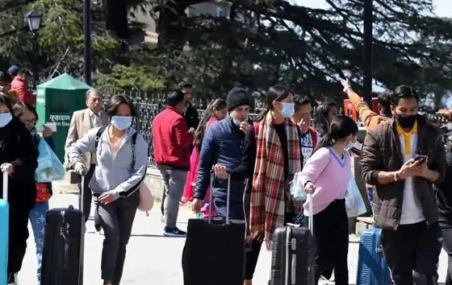
Introduction to Governance & Tourism
Governance schemes vary from region to region and from country to country.
Various sociocultural values and administrative norms lead to different governance structures.

Slide 7
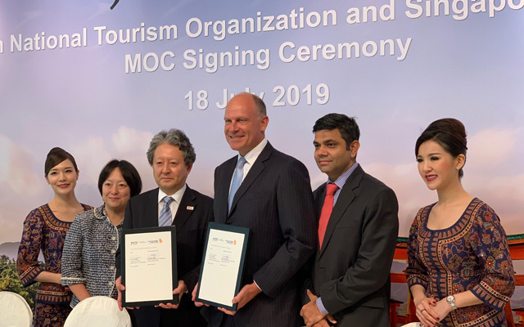
Introduction to Governance & Tourism
Presentation of Examples - Singapore

Slide 8
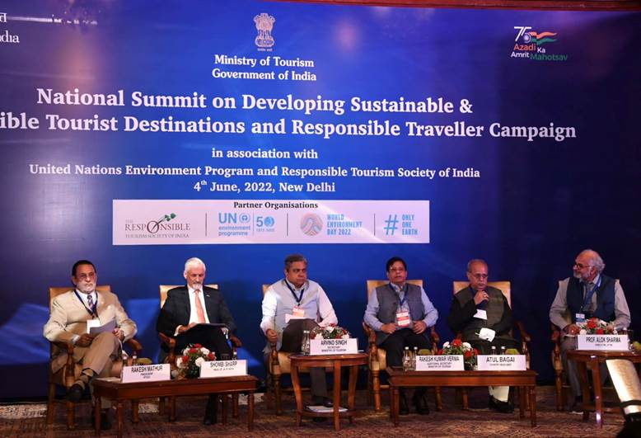
Introduction to Governance & Tourism
Presentation of Examples - India

Slide 9



Local & Regional Governance Models
Local Authorities – Tourism Authorities
Tourism Bodies and Associations
CVBs - DMOs

Slide 10


Local & Regional Governance Models
Is a DMO (Destination Management Organization) a Governance Model?

Slide 11
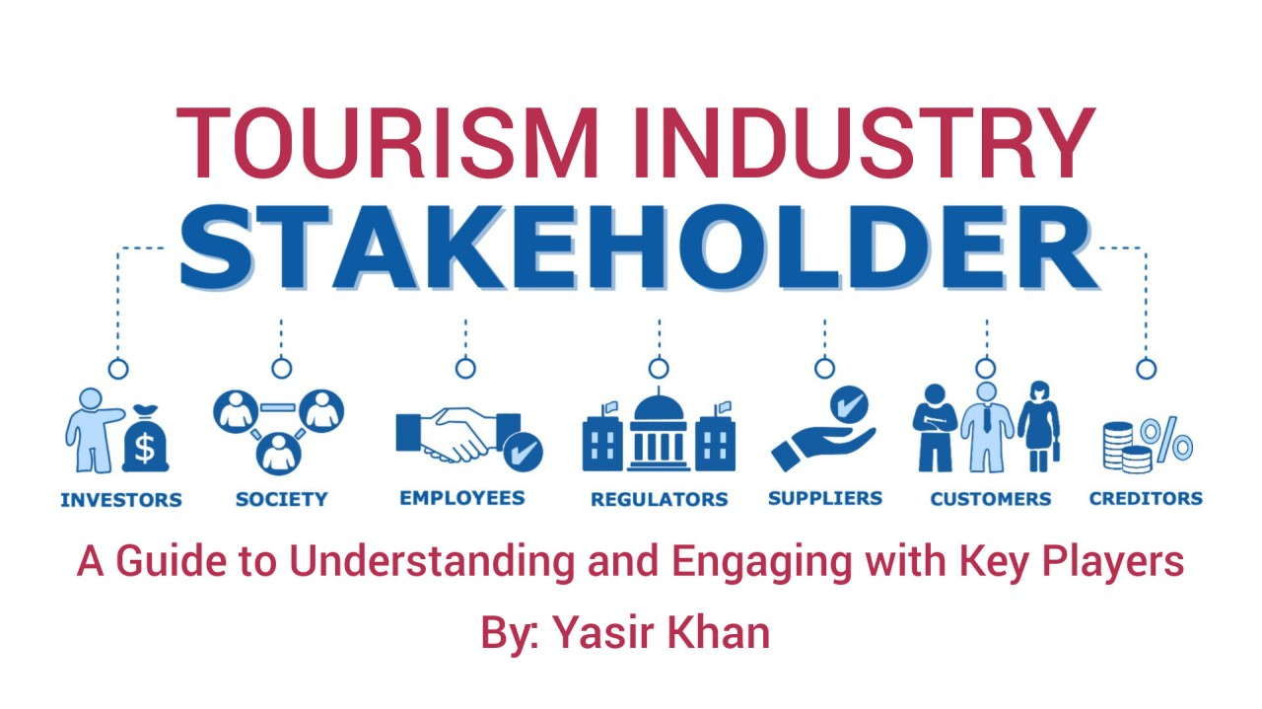
The Destination’s Stakeholders and their Role
Identifying Key Stakeholders.
Those that they are in the front line
Those who are important but not “visible”
Making CONNECTIONS

Slide 12
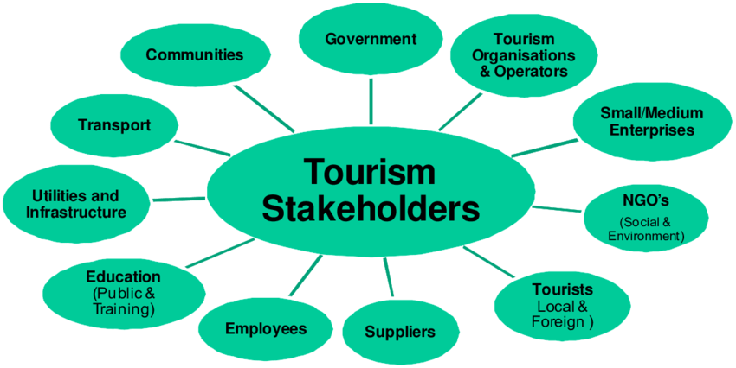
The Destination’s Stakeholders and their Role
Participation Initiatives.
Multi-participation framework
Representation and Politics
How to maintain Balance
Focus on the BIG picture

Slide 13
The Destination’s Stakeholders and their Role
Example of Key stakeholders in various DMOs
MALTA https://www.mta.com.mt/
CEO - Malta Tourism Authority https://www.mta.com.mt/
Board of Tourism Authority
Ministry of Tourism
Tourism and Professional Associations
Community Bodies

Slide 14
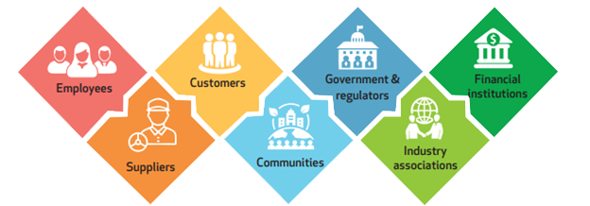
Stakeholder Engagement Strategies
Introducing an attractive common vision
Present the benefits that they ALL share
Indicate the Contribution required by EACH
Analyze the decision-making processes

Slide 15
Stakeholder Engagement Strategies
Provide Motivation and Support
Allow open communication and information flow
Transparency & Trust
Consultant(s) or Expert(s) on Board
Reporting and Dissemination

Slide 16

Stakeholder Engagement Strategies
Infuse Sustainability Values
Focus on Local-Regional Resilience
Make everybody proud for their Destination
Monitor Governance outcomes
and Analyze Data

Slide 17

Stakeholder Engagement Strategies
Some successful DMO engagement Strategies
Visit Flanders
https://www.visitflanders.com

Slide 18
Discussion about Sustainable Tourism Governance

Slide 19
Q & A
Thank You!

