Slide 1
Sustainable & Smart Tourism
Training Program
Organized by Mekong Institute (MI)
Funded by Mekong – Korea Cooperation Fund (MKCF)
November 2023

Slide 2



Sustainable Tourism Governance & Strategic Planning
MODULE 3
Trainer
November 2023

Slide 3
Presenting Strategic Planning
Session 3
Monday

Slide 4
Defining Goals and Objectives
Goal Setting Strategies
The Essence of Strategy and Strategic Skills
Stages of Planning
Successful Planning Cases

Slide 5


Defining Goals and Objectives
Goals are specific, action-based, and quantitative and require focus and clarity from our side.
Many times people confuse resolutions with goals. You should not make this mistake. Resolutions are passive, while goals are active, and goal-setting process will be the way to bring them to reality.

Slide 6
Defining Goals and Objectives
Goal setting is a process of deciding what you want to achieve and laying out a plan on how to reach that goal. It involves identifying specific objectives, setting performance targets, and evaluating your progress in achieving those goals.

Slide 7
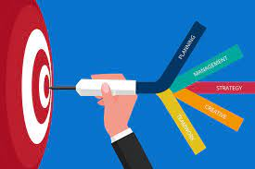
Defining Goals and Objectives
"The goal is the most critical part of the process; it's the plan you create and your actions that drive results"
James Fleming

Slide 8
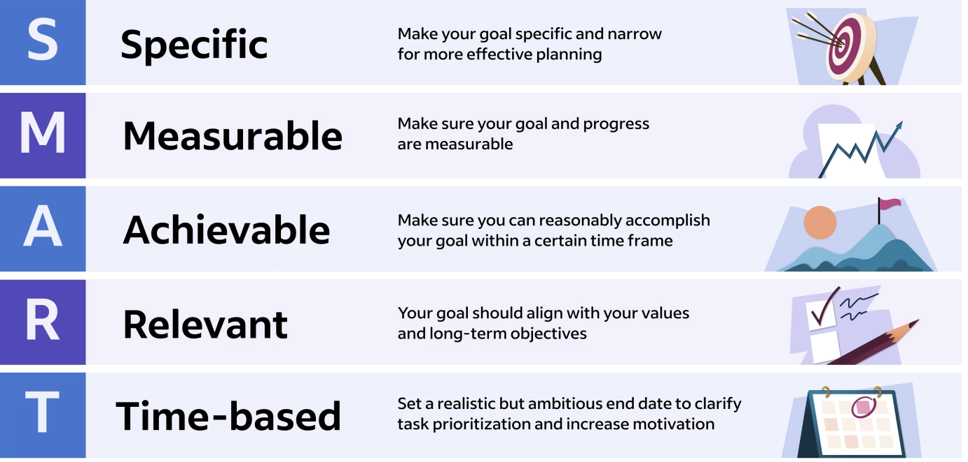
Goal Setting Strategies
Setting Goals means you can clarify your ideas and focus your efforts, which allows you to allocate your time in a way that promises the most return and the highest chance of achieving your goals.

Slide 9

Goal Setting Strategies
1. Make your goal SPECIFIC
The first step in creating a SMART goal is to make it specific. Consider your goal in quantifiable terms by asking yourself the following questions:
What do I want to accomplish?
Will achieving this goal have an important impact?
What actions will I need to take?

Slide 10
Goal Setting Strategies
2. Make your goal MEASURABLE
This step in the process prompts you to apply methods of measuring your progress toward achieving your goal. Being measurable also takes into account any actions you would implement to help you further your progress toward your goal.

Slide 11
Goal Setting Strategies
3. Make your goal ACHIEVABLE
This aspect of the strategy relates to your goal being achievable. Do you have the resources and time needed to achieve the goal? This may include gathering necessary data, asking team members for help and learning new skills. You're more likely to be successful in your goal once it is specific, measurable and deemed achievable.

Slide 12
Goal Setting Strategies
4. Make your goal RELEVANT
A relevant goal will directly contribute to successful results. Keep in mind that every action you take should move you closer to your goal. In our example, a relevant goal will directly reduce expenses.

Slide 13
Goal Setting Strategies
5. Make your goal TIME-BASED
A time-based goal has a specific time deadline. You’ll want to determine if your goal is a short-term or long-term goal (or a combination of both). Your timeline should also be realistic and allow you plenty of opportunities to make adjustments to your goal regarding its relevance, specificity and achievability.

Slide 14
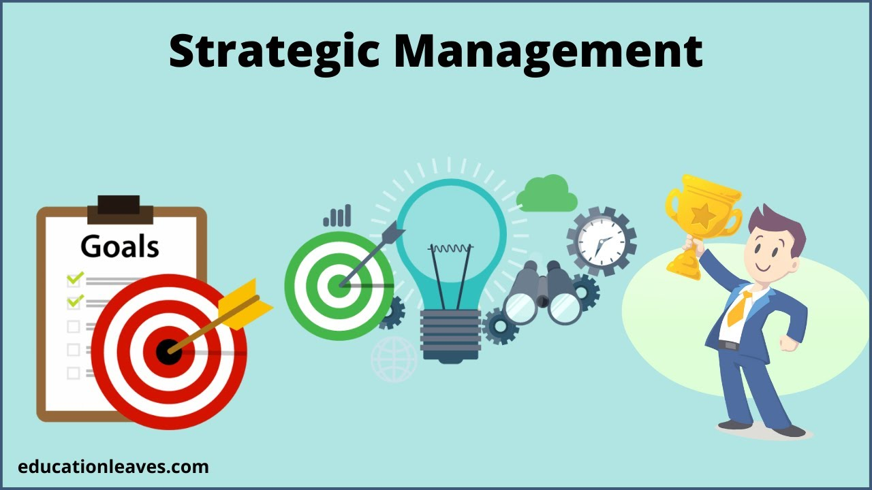
The Essence of Strategy and Strategic Skills
Strategic management is the process of planning, monitoring, analysis, and assessment of all necessities an organization needs to meet its aims

Slide 15

The Essence of Strategy and Strategic Skills
Strategic skills are abilities you can develop to help you think strategically and innovatively. These skills can help you adapt depending on the situation you're facing. Rather than being specific to an occupation or position, strategic skills focus on the personal and communicative abilities individuals need to thrive in a productive work environment.

Slide 16

Stages of Planning
Planning is the first primary function of management that precedes all other functions. The planning function involves the decision of what to do and how it is to be done?
So, managers focus a lot of their attention on planning and the planning process.

Slide 17
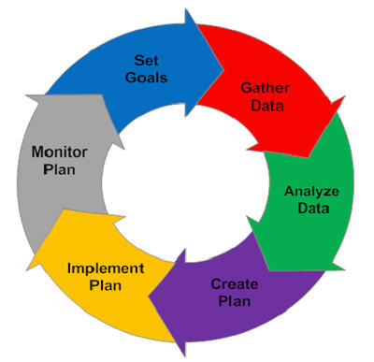
Stages of Planning
Set Goals.
Gather Data
Analyze Data
Create Plan
Implement Plan
Monitor Plan

Slide 18

Successful Planning Cases
Promoting higher-end tourism within the Annapurna Conservation Area (ACA) and identifying private sector investment opportunities.

Slide 19
Successful Planning Cases
1. Supporting heritage villages to provide diversified offer in Lower Mustang through identifying specific investment concepts and developing investment pitchbooks to be taken to market
2. Supporting linkages to market leaders for higher-end resorts and franchise opportunities along new trails in Manang.

Slide 20
Successful Planning Cases
Major Activities
1. Formulate investment plans/models for three integrated heritage villages (i.e. Tukuche, Marpha, Kagbeni) to support rural municipalities to manage the villages, with an overview of regulatory requirements to facilitate private sector investments.
2. Create an investment pitchbook of the potential traditional old heritage properties located in 3-4 villages (ie. Kagbeni, Tukuche, Marpha), approved by the ACA authorities (NTNC), and disseminate among potential investors.
3. Facilitate linkage of existing lodges to local/global heritage boutique resorts for potential management through their own brands.
4. Share global best practice examples through a seminar that includes breakout workshops and technical deep dive sessions
5. Presentation of investment concepts and pitchbook at a final seminar.

Slide 21
Successful Planning Cases
Results
Support the Government of Nepal on promoting higher end tourism in the Annapurna Conservation Area (ACA) and identifying private sector investment opportunities.

Slide 22
Discussion about Goals & Plannng Processes

Slide 23
Q & A
Thank You!

