Slide 1
Sustainable & Smart Tourism
Training Program
Organized by Mekong Institute (MI)
Funded by Mekong – Korea Cooperation Fund (MKCF)
November 2023

Slide 2
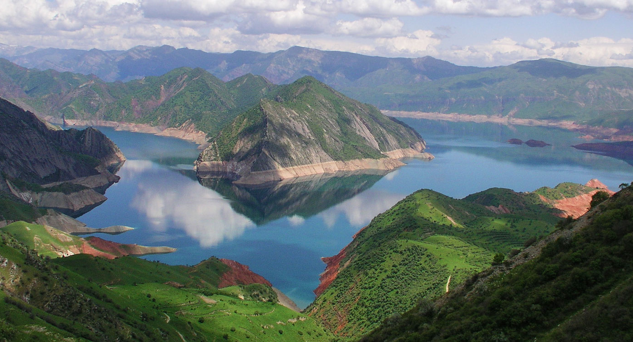


Sustainable Tourism Governance & Strategic Planning
MODULE 4
Trainer
November 2023

Slide 3
Existing Tools for Measuring
Sustainable Tourism
Session 2
Monday

Slide 4
Sustainability Indicators
Categories and variety of Indicators
Selecting the proper indicators for your place
Agree on the expected outcomes

Slide 5
Sustainability Indicators
There are specific ways that you can create proof and evidence about areas that are considered important for each tourism ecosystem.
A very common way is to use specific indicators that are measuring these sensitive areas.
We generally call them sustainability indicators.
“If you can't measure it, you can't manage it.”
Peter Drucker
“(…) providing the right data at the right time to
the right people so that they can take the right decisions.”
Nic Smith

Slide 6
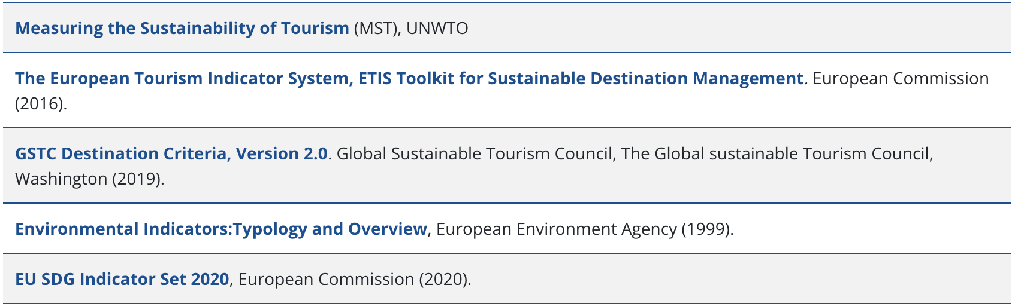
Sustainability Indicators
On a destination level there are various regional or global organizations that have created performance criteria and guidelines. Some of them are shown here:

Slide 7
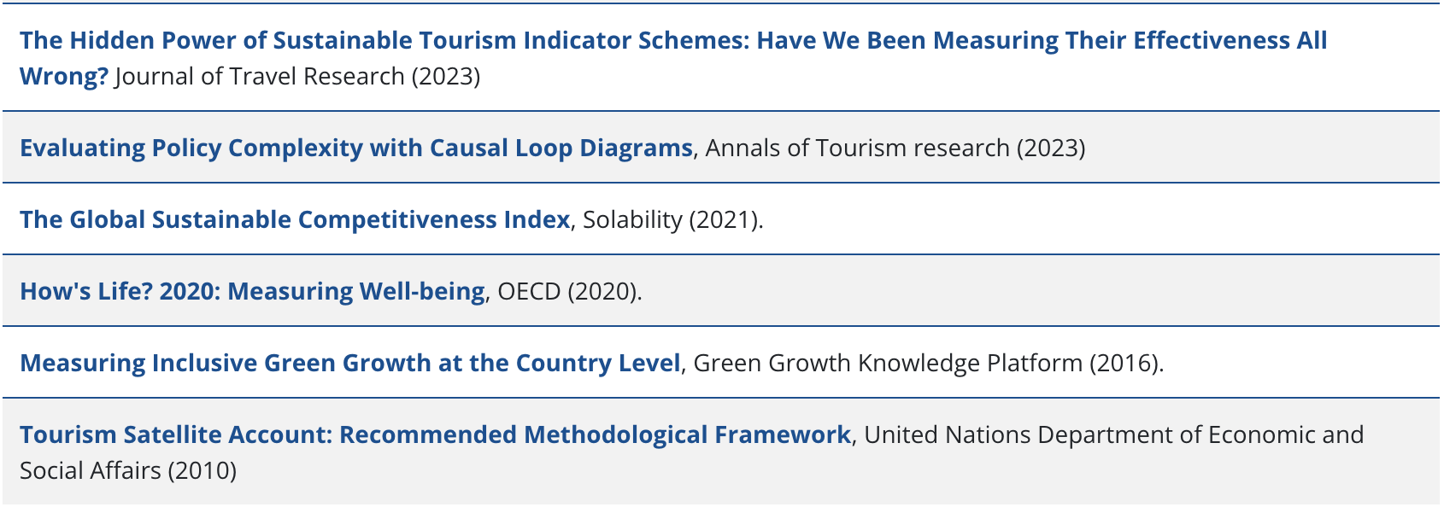
Sustainability Indicators
In any case the approach of each organization is related with the area of interest for the specific region and or the values that the organization is prioritizing.

Slide 8




Categories & Variety of Indicators
The categories and the variety of indicators offered from all those organization is a good starting point to initiate a study that will support the local and regional efforts in the desired sustainability monitoring

Slide 9
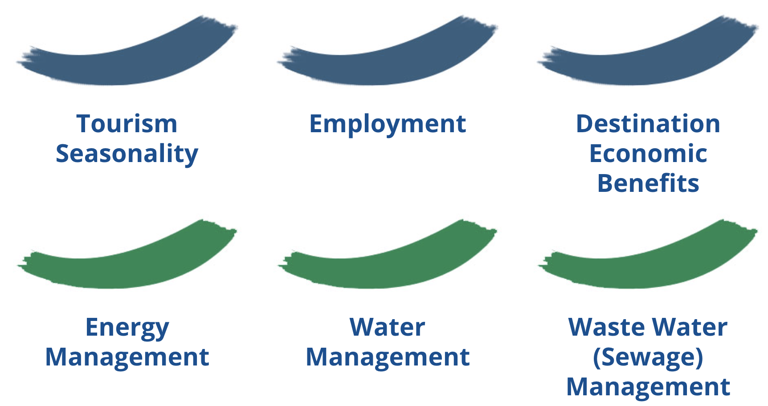
Categories & Variety of Indicators
Some indicators are created for areas that are considered important to be monitored. Here below are some common areas of interest on a global level. (1)

Slide 10
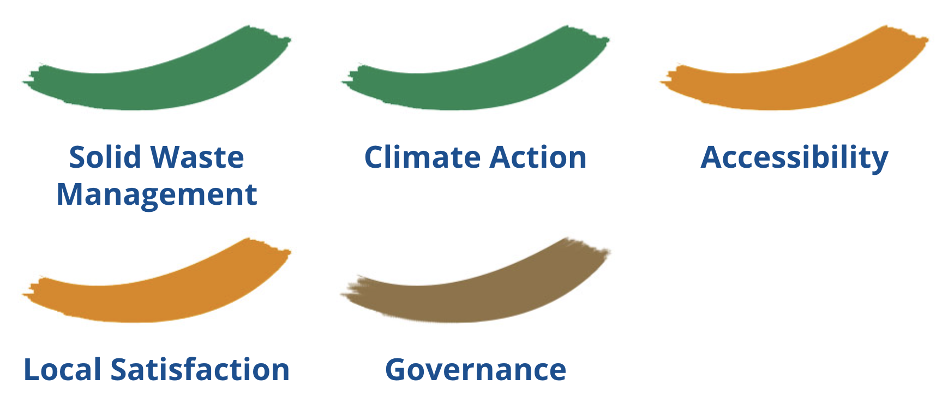
Categories & Variety of Indicators
Some indicators are created for areas that are considered important to be monitored. Here below are some common areas of interest on a global level. (2)

Slide 11
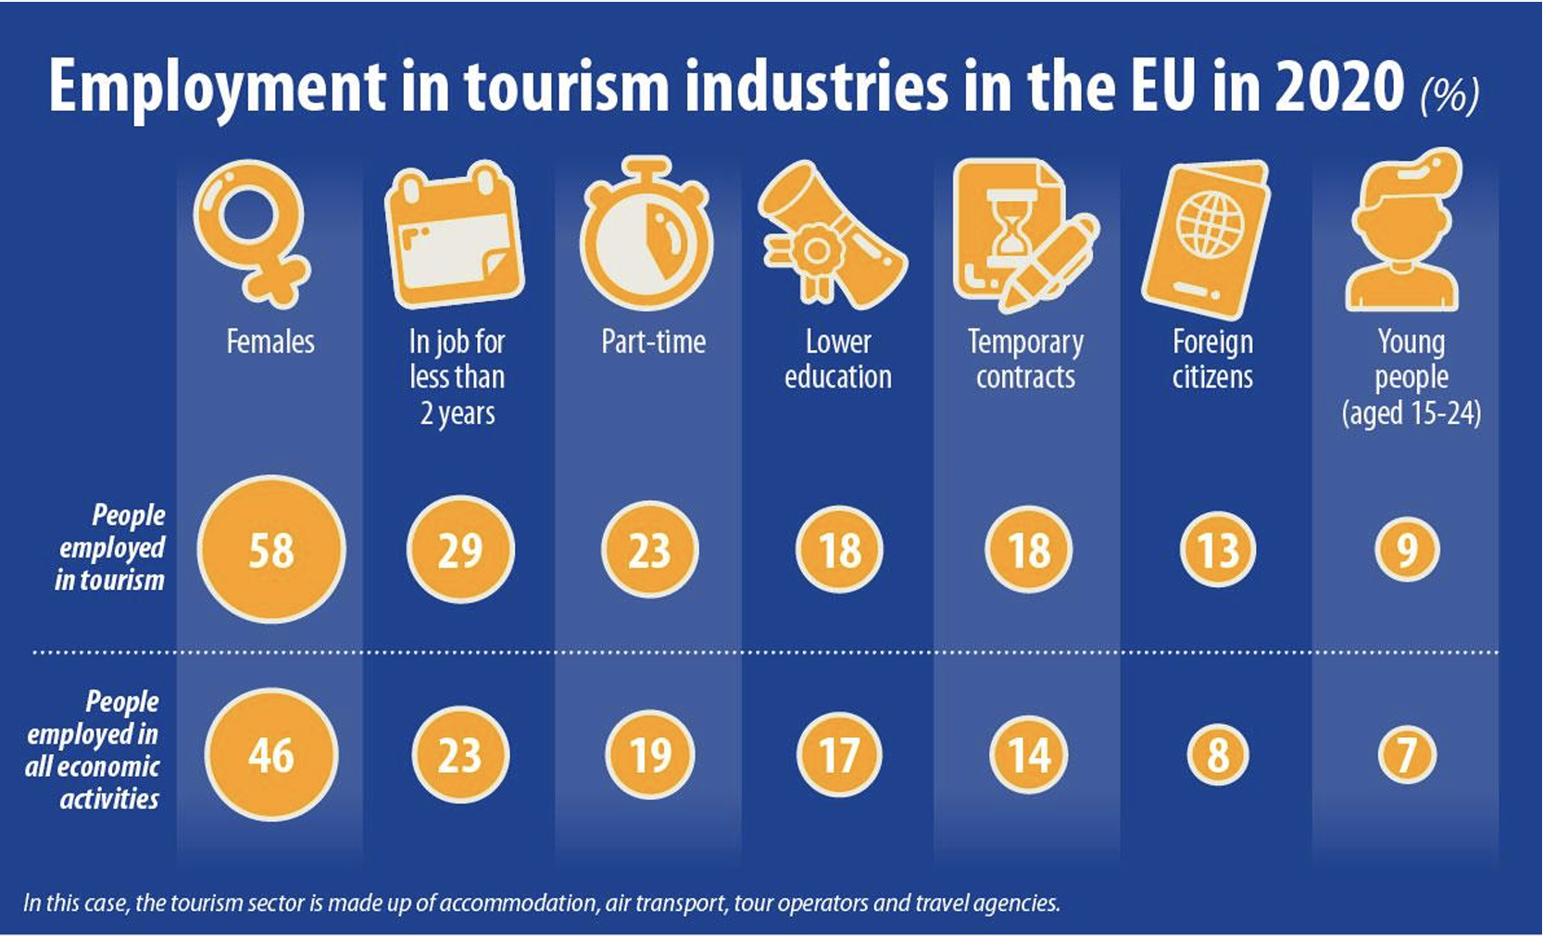
Categories & Variety of Indicators
Example (1): EU employment in Tourism

Slide 12
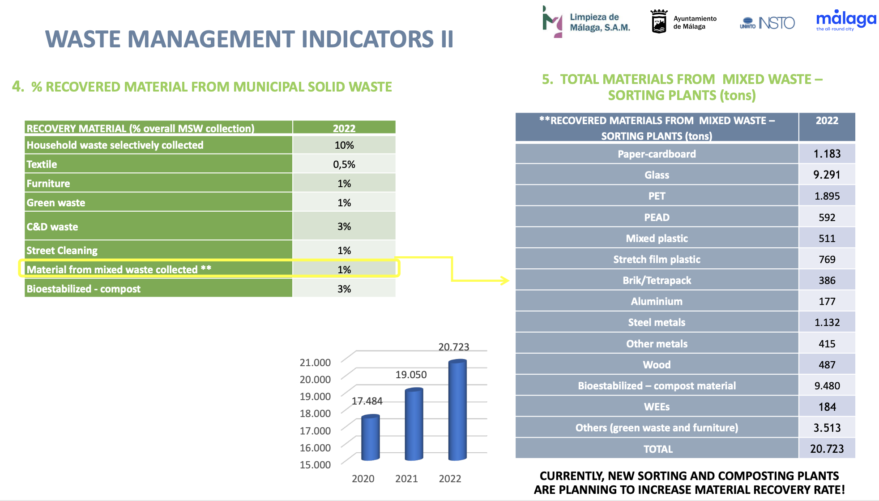
Categories & Variety of Indicators
Example (2): MALAGA - SPAIN
Waste Management Indicators

Slide 13
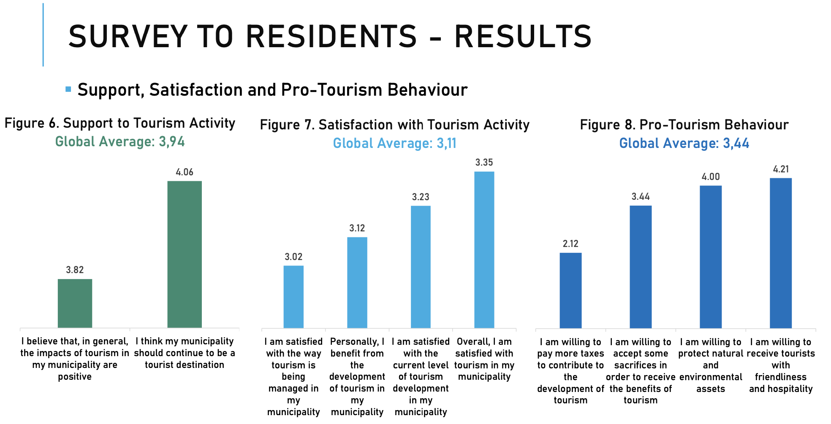
Categories & Variety of Indicators
Example (3): Residents’ Satisfaction – Algarve PORTUGAL

Slide 14
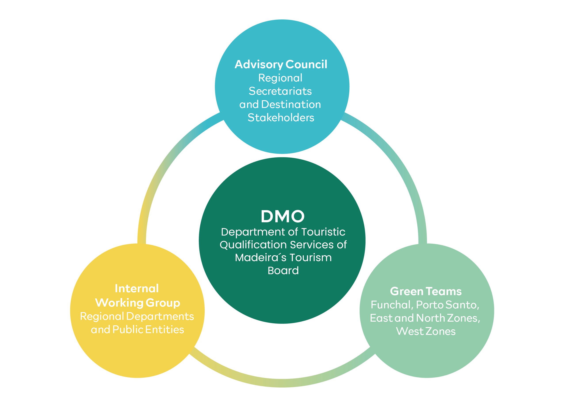

Selecting the proper Indicators for your Place
First there must be an open discussion among all stakeholders, including community bodies and experts, about what are the major sensitive areas that may need to be monitored.
A local or regional DMO can play a key role on that.

Slide 15
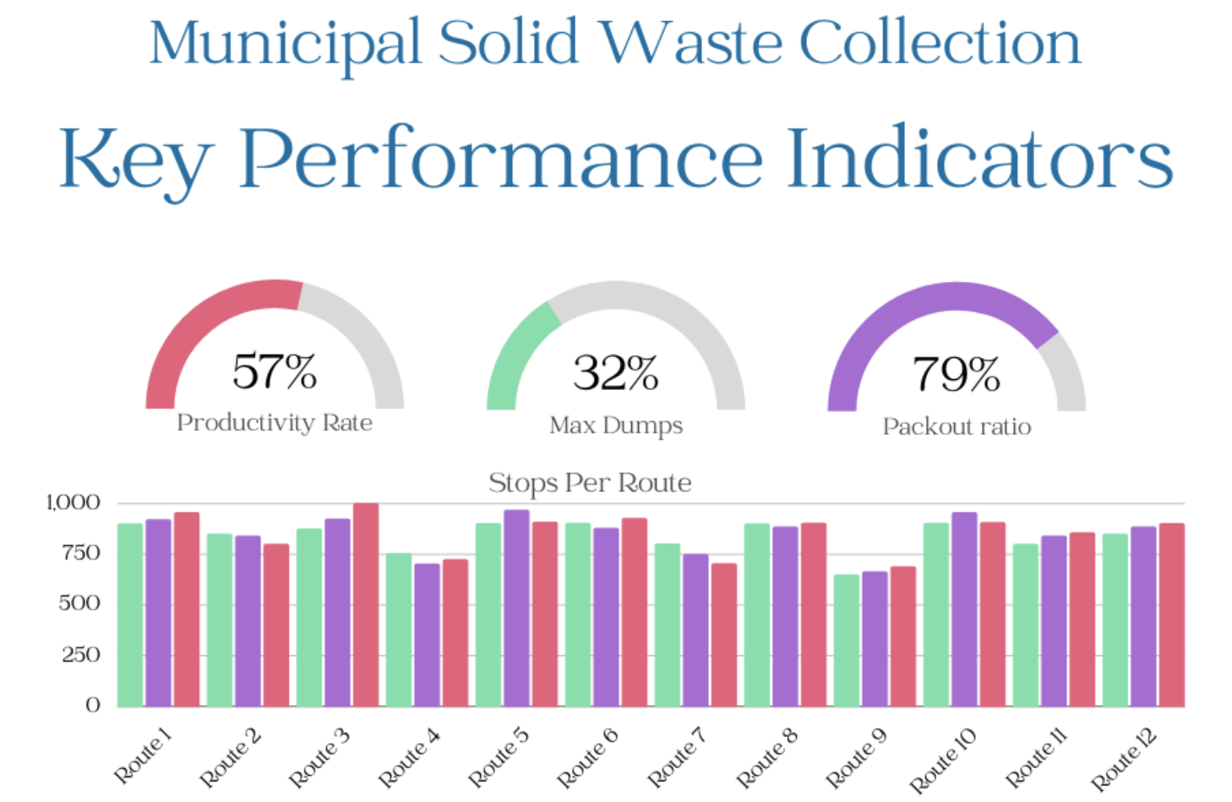
Selecting the proper Indicators for your Place
Second for each selected area of interest (e.g Waste Management) you select indicators that can provide evidence about the progress on managing waste in different time periods.

Slide 16
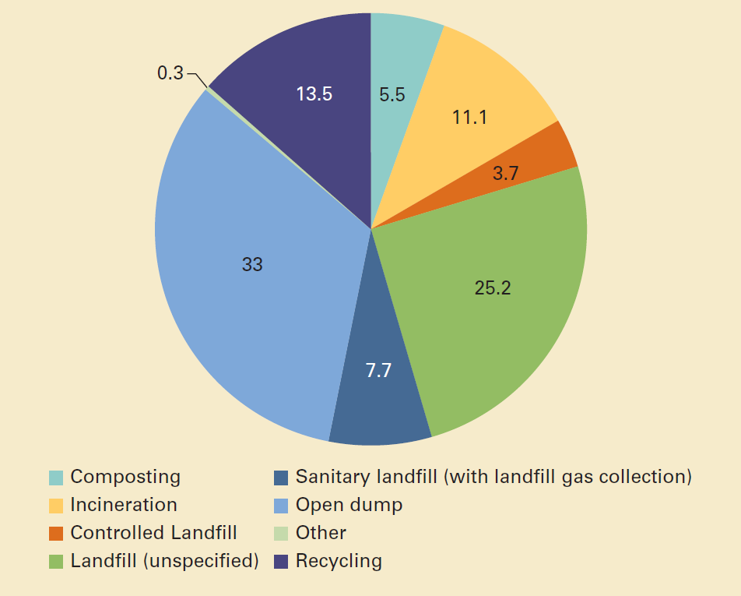
Selecting the proper Indicators for your Place
Third, you need to secure the validity of the resources of the primary data, the format of the data available and the accuracy of the information.

Slide 17
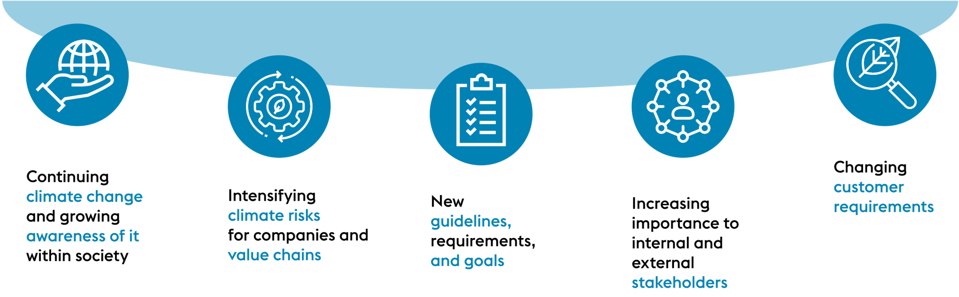
Agree on the Expected Outcomes
Even if we agree what we expect from the indicators
We need to be ready to see the evidence and hear the conclusions
And based on that we need to be ready to create new policies-strategies
AND take ACTIONS

Slide 18

Agree on the Expected Outcomes
The indicators are selected for a reason
The indicators create outcomes
These outcomes must be analyzed
From the analysis, there will be some scientific conclusions

Slide 19

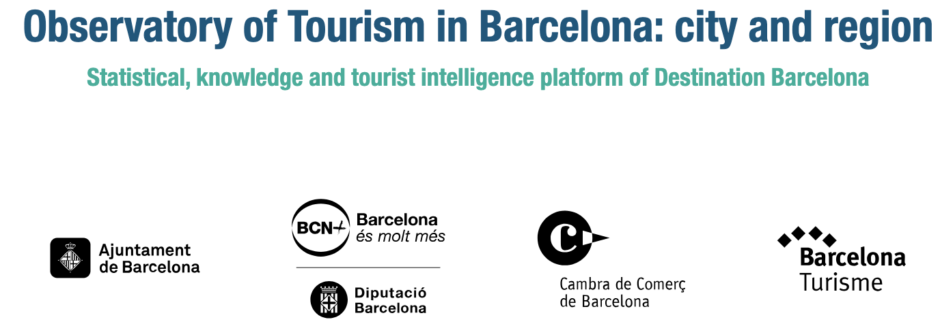
Example of an Existing Monitoring Framework
https://www.observatoriturisme.barcelona/en

Slide 20
Discussion about options for Mekong Region

Slide 21
Q & A
Thank You!

