Slide 1
Sustainable & Smart Tourism
Training Program
Organized by Mekong Institute (MI)
Funded by Mekong – Korea Cooperation Fund (MKCF)
November 2023

Slide 2
Sustainable Tourism Governance & Strategic Planning
MODULE 4
Trainer
November 2023

Slide 3
Carrying Capacity Concept & Successful Examples for Sustainability Measurement
Session 4
Monday

Slide 4
Background for assessing Carrying Capacity
Carrying Capacity Methodology (ESPON-EU)
Overview of Results and Case Studies
Strategic Guidelines
Examples

Slide 5
Background for assessing Carrying Capacity (ESPON-EU)
The aim of this ESPON Targeted Analysis project is to develop a methodology for measuring the carrying capacity of touristic destinations, based on a review of existing methodologies. This methodology was tested it in four case study destinations located in Slovenia (Bled, Brežice and Divača) and one in a cross-border destination of Nova Gorica/Gorizia at the Slovenian and Italian border.
Final products of the project are a comprehensive handbook leading through the methodological steps to assess the carrying capacity of any destination, a supporting visualization tool (dashboard) as well as territorial evidence on the impact of tourism in the case study regions along with recommendations on managing tourism flows to ensure sustainable development of the region (case study reports).

Slide 6
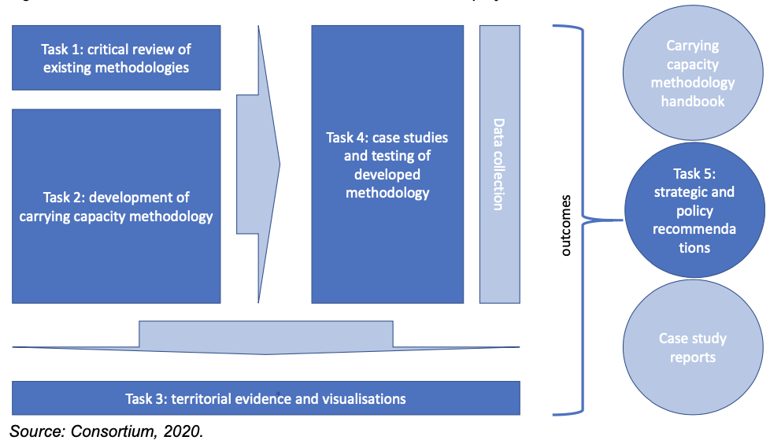
Background for assessing Carrying Capacity
The relation between different tasks and outcomes of this project is presented on the figure below.

Slide 7
Carrying Capacity Methodology
Existing Methodology Review
• There is no single denominator for carrying capacity – a multitude of aspects in the socio-economic context of destinations are touched upon and carrying capacity is strongly related to the dimensions of sustainability and its conceptual components (i.e. economy, society and the environment).
Still the challenge is to establish a causality between tourism as a sub-sector of the economy and spatial phenomena (flows and concentration) and all these multiple aspects.

Slide 8
Carrying Capacity Methodology
Existing Methodology Review
• There is no single way of capturing the carrying capacity along the different dimensions. The methodological approach meets this challenge by allowing for different ways to assess normative borders for carrying capacities.
While for some indicators carrying capacity is to be understood as staying within a limit or getting closer to it (e.g. economic growth induced by tourism), for other indicators it would mean to stay within a corridor of an “optimal” condition (e.g. biodiversity within a tourist destination), while getting closer to the limit would indicate a critical condition. In other words, the method will have to be able to deal with various ways to describe and measure the target values of carrying capacity.

Slide 9
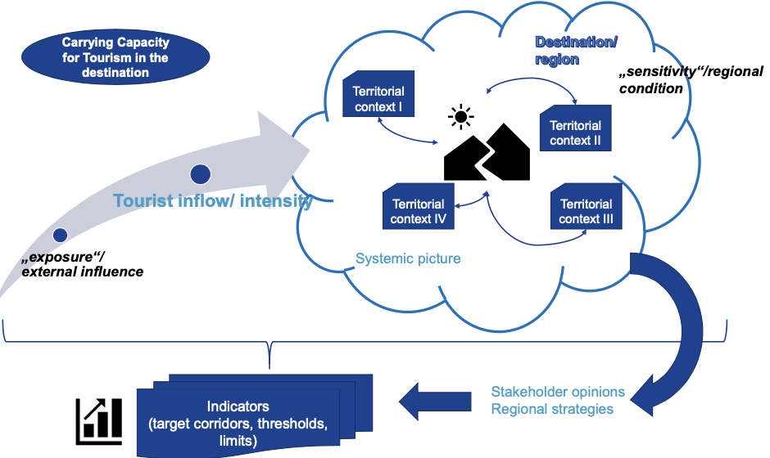
Carrying Capacity Methodology

Slide 10
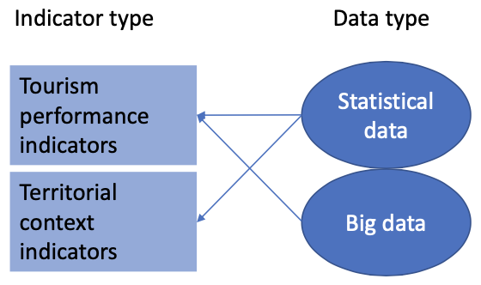
Overview of Results and Case Studies
Step 1: Destination’s overview
Step 2: Identification of causal loops between tourism and the territorial context
Step 3: Measurement of tourism flows
Step 4: Identification of tourism impact based on tourism and territorial context
Step 5: Identification of carrying capacity

Slide 11
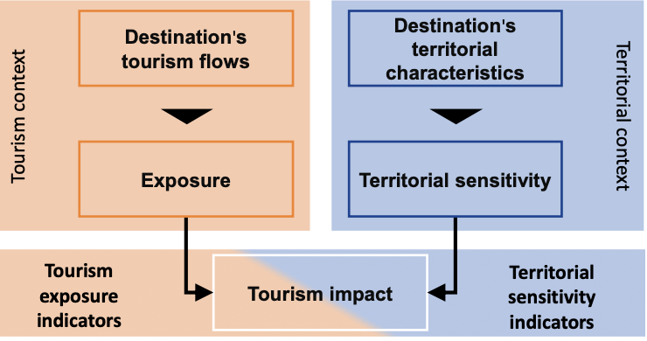
Overview of Results and Case Studies
Combining pairs of indicators in a grid to capture the relationship between the tourism and territorial context over time

Slide 12
Overview of Results and Case Studies
Can you imagine a promising development plan?
What are the main Actions to be implemented?

Slide 13
Strategic Guidelines
Evaluating the tourism and territorial context relationship by benchmarking
• Carrying capacity itself is an “optimization problem” – assuming that there is a “border situation” of the territorial context, where one additional unit of input (in our case tourism intensity) will result in a crossing of the capacity threshold.
• On the other hand we pointed out that there will be no strict threshold which may be established, but territorially specific situations or target corridors defining the carrying capacity.
• Still one crucial element of determining the carrying capacity of a tourist destination will be the comparative element positioning the performance of a single destination vis-à-vis the threshold/ borderline of carrying capacity.

Slide 14
Strategic Guidelines
Indicator identification process
• Compilation of a list of exemplary indicators based on the existing methodologies from the Literature
• Adaptation of the indicator list for specific destinations: consideration of destination-specific needs and policy goals (step 1 in the methodology) and development of a detailed systemic picture of tourism impacts.
• Finalisation of the indicator lists: the finalisation of the indicator lists focuses on the distribution of indicators along the three dimensions of sustainability and an adequate allocation of context and tourism performance indicators.
• Identification of data sources: after the finalisation of the indicator list, the data sources for each indicator needs to be identified in cooperation with the stakeholders in the destination.

Slide 15
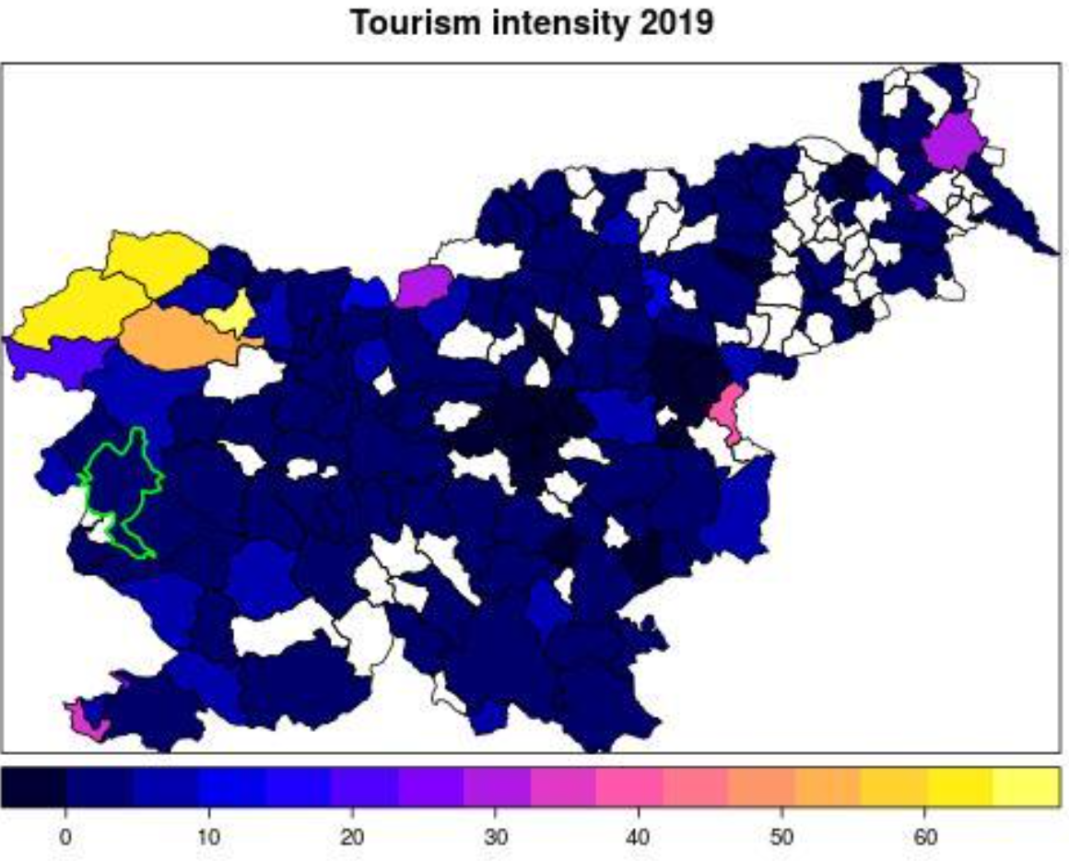
Examples
Nova Gorica

Slide 16
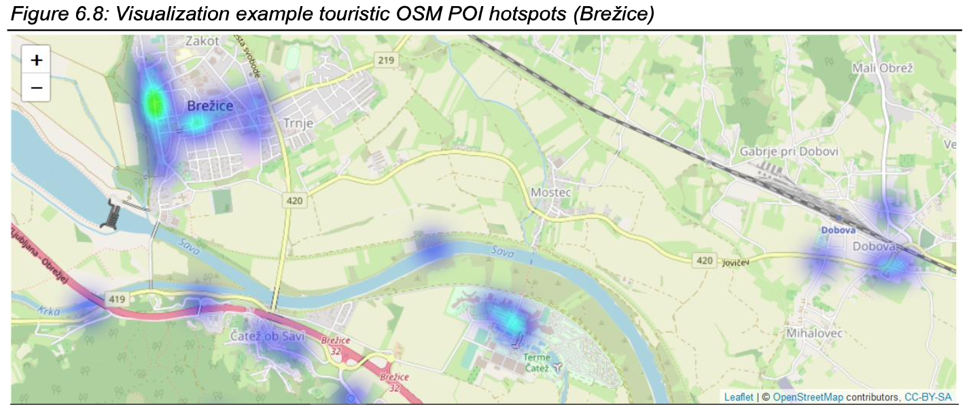
Examples
Brezice – Hot Spots

Slide 17
Discussion about Carrying Capacity in Mekong Region

Slide 18
Q & A Thank You!

