Slide 1
Sustainable & Smart Tourism
Training Program
Organized by Mekong Institute (MI)
Funded by Mekong – Korea Cooperation Fund (MKCF)
November 2023

Slide 2



Smart Tourism & Sustainability
MODULE 5
Trainer
November 2023

Slide 3
How Smart Tourism Contributes to Sustainable Tourism
Session 3
Monday

Slide 4
Accelerating Sustainability Policies
Leveraging Digital Information and Big Data
Efficient Sustainability Management
Smart Communication for Sustainability

Slide 5

Accelerating Sustainability Policies
Smart tourism accelerates sustainability by leveraging data-driven decision-making, promoting sustainable mobility options, and enhancing resource management and conservation efforts. By integrating technology and eco-friendly practices into their tourism strategies, destinations can reduce their environmental footprint and create a more sustainable and enjoyable experience for visitors..

Slide 6
Accelerating Sustainability Policies
Here are three ways in which smart tourism can accelerate sustainability:
1. Data-Driven Decision Making:
Smart tourism relies on data analytics and real-time information to make more informed decisions about resource management, crowd control, and environmental impact. By collecting and analyzing data from various sources, such as visitor behavior, weather patterns, and energy consumption, destinations can optimize their operations.
For example, they can adjust transportation routes to reduce congestion and emissions, allocate resources more efficiently, and minimize energy usage in accommodations. This data-driven approach enables destinations to make sustainable choices and reduce their ecological footprint.

Slide 7
Accelerating Sustainability Policies
2. Sustainable Mobility Solutions:
Smart tourism promotes sustainable transportation options, such as electric buses, bike-sharing programs, and ride-sharing services. By providing visitors with eco-friendly alternatives to traditional car rentals or taxis, destinations can reduce traffic congestion, air pollution, and carbon emissions.
Additionally, smart tourism can integrate real-time information and mobile apps to encourage travelers to use public transportation, carpooling, or even walking and cycling for short distances. This not only reduces the environmental impact of tourism but also enhances the overall experience for visitors.

Slide 8
Accelerating Sustainability Policies
3. Resource Management and Conservation:
Smart tourism technologies can help destinations better manage their natural resources and protect their ecosystems. For example, using sensors and data analytics, national parks and wildlife reserves can monitor the movement of tourists to prevent overcrowding in sensitive areas, thereby minimizing environmental degradation.
Moreover, smart waste management systems can optimize the collection and recycling of waste in tourist areas, reducing litter and its negative impact on the environment. By preserving the natural beauty and biodiversity of their regions, destinations can ensure the long-term sustainability of their tourism industries.

Slide 9
Leveraging Digital Information and Big Data
Promoting sustainable tourism through the use of digital information and big data is crucial for reducing the environmental and social impact of the tourism industry. Here are three ways to achieve this:
1. Data-Driven Destination Management:
Utilize big data analytics to monitor and manage tourist flows. By collecting and analyzing data from various sources, such as mobile apps, social media, and sensors, destinations can gain insights into tourist behavior and preferences. This information can be used to optimize transportation, crowd management, and resource allocation, reducing congestion and minimizing the environmental impact of over-tourism in popular destinations.

Slide 10
Leveraging Digital Information and Big Data
2. Personalized Eco-Friendly Travel Recommendations:
Develop digital platforms and applications that provide travelers with personalized recommendations for eco-friendly travel experiences. By analyzing user preferences, such as interests, travel history, and environmental values, these platforms can suggest sustainable destinations, accommodations, and activities.
Additionally, they can promote responsible practices, such as eco-conscious lodging, low-impact transportation options, and eco-tours, to encourage travelers to make more sustainable choices.

Slide 11
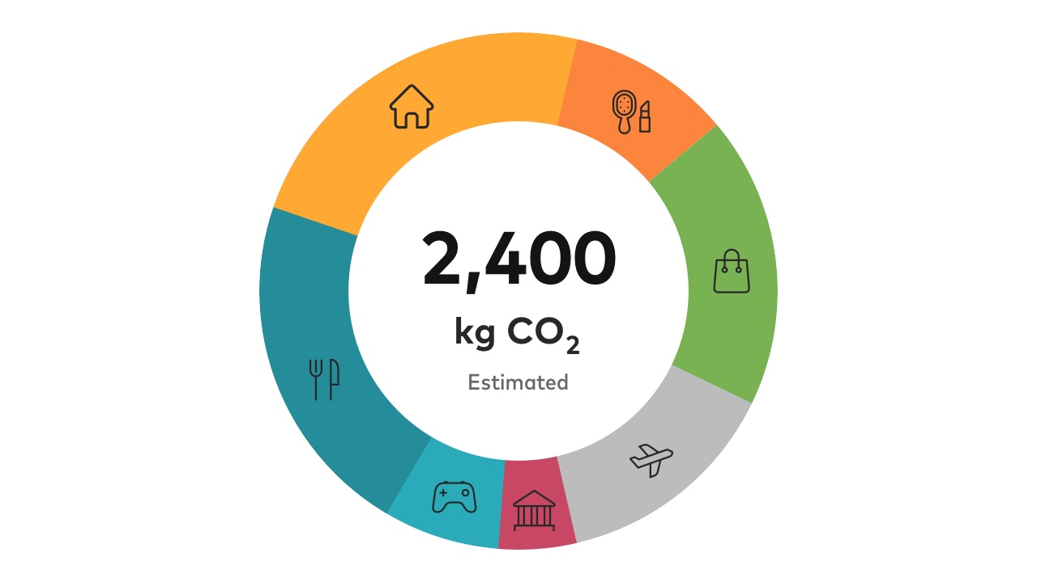
Leveraging Digital Information and Big Data
3. Carbon Footprint Tracking and Offset:
Implement digital tools that allow travelers to track and offset their carbon footprint during their trips. By integrating data from transportation, accommodation, and activities, tourists can easily calculate their environmental impact.
Many platforms now offer carbon offset options, allowing travelers to contribute to environmental initiatives to compensate for their emissions.
This not only raises awareness about sustainability but also provides a practical way for travelers to take responsibility for their carbon emissions

Slide 12

Efficient Sustainability Management
Smart tourism promotes efficiency in managing sustainable tourism by leveraging data-driven decision-making, optimizing resource management, and enhancing visitor engagement and education.
These technologies help destination managers make informed choices, reduce environmental impact, and promote responsible behavior among tourists, all of which contribute to the long-term sustainability of tourist destinations.

Slide 13
Efficient Sustainability Management
Here are three ways in which smart tourism helps manage sustainable tourism more efficiently:
1. Data-Driven Decision-Making:
Smart tourism relies on the collection and analysis of data from various sources, such as sensors, mobile apps, and social media. This data provides valuable insights into tourist behavior, traffic patterns, and environmental impacts. By making use of this data, destination managers can make informed decisions about resource allocation, traffic management, and waste reduction.
For example, data can help identify peak tourist seasons, allowing for better planning of public transportation and waste collection, reducing congestion and environmental impact.

Slide 14
Efficient Sustainability Management
2. Improved Resource Management:
Smart tourism enables more efficient resource management in sustainable tourism destinations. For instance, the Internet of Things (IoT) devices can monitor water and energy consumption in hotels and other facilities, helping to reduce waste and promote sustainability.
Additionally, smart grids and energy-efficient technologies can be implemented to better manage energy usage, while smart waste management systems can optimize waste collection routes and schedules, reducing the environmental impact of tourism.

Slide 15
Efficient Sustainability Management
3. Enhanced Visitor Engagement and Education:
Technology plays a crucial role in educating tourists about responsible and sustainable behaviors. Mobile apps and augmented reality (AR) experiences can provide visitors with information about eco-friendly activities, cultural preservation, and responsible tourism practices.
By engaging tourists in a meaningful way, smart tourism helps raise awareness about sustainability and encourages visitors to make more responsible choices during their trips, such as reducing water and energy consumption, supporting local communities, and respecting natural habitats.

Slide 16

Smart Communication for Sustainability
Smart digital communication can support sustainable tourism by providing real-time information, promoting responsible travel choices, and raising awareness among tourists about the need to protect natural and cultural resources.
These tools empower travelers to make informed decisions that minimize their environmental and social impact, thus contributing to the long-term sustainability of tourism destinations.

Slide 17
Smart Communication for Sustainability
Here are three ways in which it can contribute to sustainable tourism:
1. Real-time Information and Guidance:
Smart digital communication tools such as mobile apps, websites, and social media platforms can provide travelers with real-time information about local attractions, events, and environmental conditions.
This enables tourists to make informed decisions about their activities, reducing the negative impact on sensitive ecosystems. For example, apps can offer real-time weather updates, trail conditions, and wildlife spotting tips, helping tourists plan their visits in a way that minimizes disruptions to natural habitats.

Slide 18
Smart Communication for Sustainability
2. Sustainable Travel Recommendations:
Smart digital platforms can offer sustainable travel recommendations by suggesting eco-friendly accommodations, transportation options, and activities. They can provide information on hotels and tour operators that prioritize environmental conservation and community engagement.
This encourages tourists to support businesses that follow sustainable practices, thereby promoting responsible tourism and minimizing the environmental and social impact of their visits..

Slide 19
Smart Communication for Sustainability
2. Sustainable Travel Recommendations:
Education and Awareness:
Digital communication can be used to educate and raise awareness among tourists about the importance of sustainable tourism. Through interactive websites, blogs, and social media, travelers can access information on local cultures, conservation efforts, and responsible travel guidelines. Interactive maps, audio guides, and virtual reality experiences can also help visitors understand the cultural and environmental significance of the places they are exploring. This education fosters a sense of responsibility and respect for the destinations they visit, leading to more sustainable travel behavior.

Slide 20
Discussion about Smart Suatainable Destinations

Slide 21
Q & A
Thank You!

