Slide 1
Sustainable & Smart Tourism
Training Program
Organized by Mekong Institute (MI)
Funded by Mekong – Korea Cooperation Fund (MKCF)
November 2023

Slide 2
Smart Tourism & Sustainability
MODULE 5
Trainer
November 2023

Slide 3
Sustainable Tourism Strategy and Planning based on Smart and Digital resources
Session 4
Monday

Slide 4
Strategy and Planning for Tourism Destinations
Infusing Sustainability Values in the Strategy
Use of Big Data and Digital resources
From Smart Strategy to Sustainable Tourism – Best Cases

Slide 5
Strategy and Planning for Tourism Destinations
Strategy and planning for tourism destinations involve several key steps to develop a comprehensive and effective plan for sustainable tourism growth. While the specific steps may vary depending on the destination and its unique characteristics, the following eight main steps provide a general framework for the process:
1. Assessment of Current Situation:
Begin by conducting a thorough assessment of the destination's current tourism situation. This should include an analysis of existing infrastructure, visitor demographics, tourism trends, and the economic and environmental impacts of tourism.
2. Stakeholder Engagement:
Involve key stakeholders such as government agencies, local communities, tourism businesses, and NGOs in the planning process. Their input and support are crucial for successful planning and implementation.

Slide 6
Strategy and Planning for Tourism Destinations
3. Setting Objectives and Goals:
Define clear and measurable objectives for tourism development. These objectives should align with the destination's long-term vision and consider factors like economic growth, environmental sustainability, and social well-being.
4. Market Research and Target Audience:
Conduct market research to identify target markets and understand the preferences and behaviors of potential visitors. This information is vital for creating marketing strategies and designing tourism products and services.
5. Product Development:
Develop and diversify tourism products and experiences that cater to the needs and interests of the target audience. This may involve creating new attractions, improving infrastructure, and enhancing the visitor experience.

Slide 7
Strategy and Planning for Tourism Destinations
6. Sustainability Planning:
Integrate sustainability principles into the destination's tourism strategy. This includes managing environmental impacts, preserving cultural heritage, and ensuring the well-being of the local community. Sustainable practices are essential for long-term success.
7. Marketing and Promotion:
Develop a marketing and promotion plan to attract tourists to the destination. This should include branding, advertising, digital marketing, and public relations efforts to raise awareness and generate demand.
8. Monitoring and Evaluation:
Continuously monitor the performance of the destination and assess whether it is meeting its objectives. Adjust the strategy as needed and make improvements based on feedback and data analysis. Regular evaluation helps ensure the plan's effectiveness and adaptability.

Slide 8
Infusing Sustainability Values in the Strategy
Infusing sustainability values into tourism strategy and planning is essential for promoting responsible and eco-friendly tourism. Here are three ways to achieve this:
1. Community Engagement and Empowerment:
Involve local communities in the decision-making process when developing tourism strategies. Engage in open dialogues and listen to their concerns and ideas.
Develop partnerships with local communities, helping them take an active role in tourism development. Encourage community-based tourism initiatives.
Ensure that tourism benefits are distributed equitably among the local population, providing economic opportunities, jobs, and education.

Slide 9
Infusing Sustainability Values in the Strategy
2. Environmental Conservation:
Conduct thorough environmental assessments and adopt sustainable development practices. Avoid overdevelopment, and protect natural resources such as water, forests, and wildlife.
Implement eco-friendly infrastructure and practices, such as renewable energy sources, waste reduction and recycling programs, and low-impact transportation options.
Educate tourists about the importance of respecting and preserving the environment. Enforce responsible behavior and promote eco-conscious activities, such as wildlife watching and eco-trekking.

Slide 10
Infusing Sustainability Values in the Strategy
3. Cultural Heritage Preservation:
Recognize and celebrate the cultural heritage of the destination. Encourage tourists to respect local customs, traditions, and cultural sites.
Develop and enforce responsible tourism guidelines to protect historic and cultural landmarks. Limit visitor numbers if necessary to prevent over-tourism.
Invest in cultural education programs and local artisans, promoting authentic cultural experiences and supporting the preservation of local heritage.

Slide 11
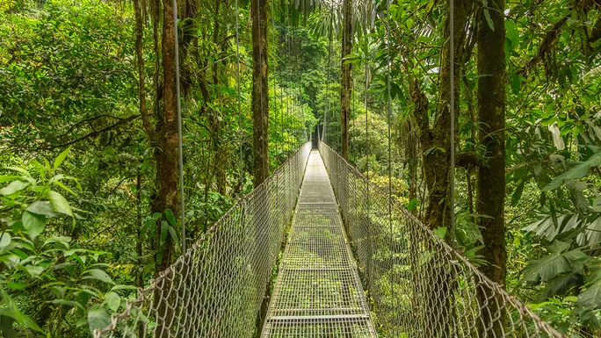
Infusing Sustainability Values in the Strategy
Incorporating these principles into tourism strategy and planning will help destinations not only attract tourists interested in responsible travel but also ensure the long-term sustainability of the tourism industry.
It's crucial to balance economic growth with environmental and social well-being, considering the needs of both tourists and the host communities.

Slide 12
Use of Big Data and Digital resources
Developing a destination strategy using Big Data and digital resources involves leveraging data and technology to make informed decisions for the growth and development of a specific location or tourism destination.
Here are three key steps to support destination strategy development:
Data Collection and Analysis:
a. Identify Relevant Data Sources
b. Big Data Analytics: Utilize Big Data analytics tools and techniques to process and analyze the collected data.
c. Geospatial Analysis: Geospatial data can be especially valuable in destination strategy development.

Slide 13
Use of Big Data and Digital resources
2. Stakeholder Collaboration and Engagement:
a. Engage Local Businesses and Government: Involve local businesses, government agencies, and community stakeholders in the strategy development process. Share your data-driven insights and collaborate to align interests and objectives. For example, if data shows that a particular area is underutilized, you can work with local businesses to develop new attractions or services.
b. Public Engagement: Use digital resources such as social media, websites, and mobile apps to engage with the public and gather their input. Run surveys, collect feedback, and encourage residents and visitors to participate in the decision-making process. This can help ensure that the strategy meets the needs and desires of the community.

Slide 14
Use of Big Data and Digital resources
Strategy Implementation and Monitoring:
a. Actionable Insights: Translate the data-driven insights into actionable strategies.
b. Continuous Monitoring: Implement a system for continuous monitoring and feedback collection.
c. Data-Driven Marketing: Utilize digital resources for targeted marketing campaigns.

Slide 15
Use of Big Data and Digital resources
Incorporating Big Data and digital resources into destination strategy development enables more informed decision-making, better resource allocation, and a higher likelihood of achieving the desired outcomes for the destination's growth and development.
It's important to combine data analysis with stakeholder collaboration and continuous monitoring for a comprehensive and effective approach.

Slide 16
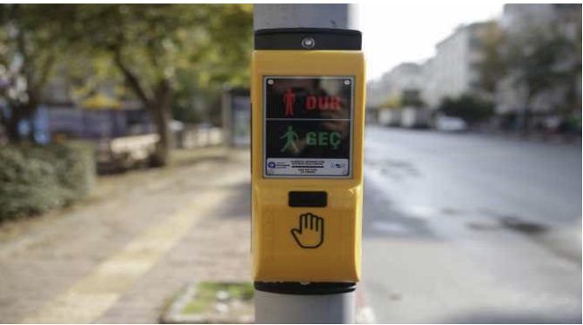
From Smart Strategy to Sustainable Tourism: Best Cases
Accessibility and Safety: Antalya; Seville
Acoustic Pedestrian Warning Device System; Antalya: The Acoustic Pedestrian Warning Device System applications were implemented at the intersections in different parts of the city in Antalya.
It aims to make the pedestrian crossings at signalised intersections safer and available for independent use for the visually impaired and elderly people. With the Acoustic Pedestrian Warning Device, when the pedestrian signal transmitters change colour, audible messages are given to the pedestrians, allowing them to cross the street or wait.
Find out more at: https://raillynews.com/2020/12/Traffic-lights-will-speak-for-the-visuallyimpaired-in-Antalya/

Slide 17
From Smart Strategy to Sustainable Tourism: Best Cases
Accessible and Safe celebrations; Seville:
The city of Seville celebrates and hosts some of the most popular events around the world with millions of visitors allowing the public spaces to be transformed and explored. As a consequence, Seville has adopted a series of accessibility measures such as integrated maps and routes that are available on the SEVILLE ACCESSIBLE
app as well as accessible signage at events.
A prime example of such measures is the Feria de Abril event that also has noiseless schedules and accessible attractions to provide an opportunity for everyone to enjoy these festivities.

Slide 18
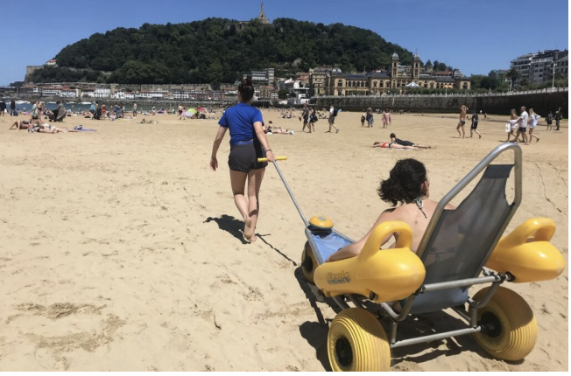
From Smart Strategy to Sustainable Tourism: Best Cases
La Concha Beach, assisted bathing service; San Sebastián:
The tide makes it difficult to install permanent footbridges during the summer season, however, the La Concha Beach has an assisted bathing service.
The latter includes the use of an “amphibious vehicle” that, with the help of one or two monitors, allows mobility both on the sand and in the water. This system allows people with reduced mobility to enjoy the beach.
A prime example of such measures is the Feria de Abril event that also has noiseless schedules and accessible attractions to provide an opportunity for everyone to enjoy these festivities.

Slide 19
Discussion about Strategy for Sustainable Tourism

Slide 20
Q & A Thank You!

