Slide 1
Sustainable & Smart Tourism
Training Program
Organized by Mekong Institute (MI)
Funded by Mekong – Korea Cooperation Fund (MKCF)
November 2023

Slide 2



Developing Adaptive Capacities for Resilient Tourism Ecosystems.
MODULE 6
Trainer
November 2023

Slide 3
Resilience and Sustainability
Session 1
Monday

Slide 4
Comprehend the interplay between sustainability and resilience.
Recognize the significance of integrating resilience into business environments, including SMEs.
Explore the resilience of tourism destinations.

Slide 5
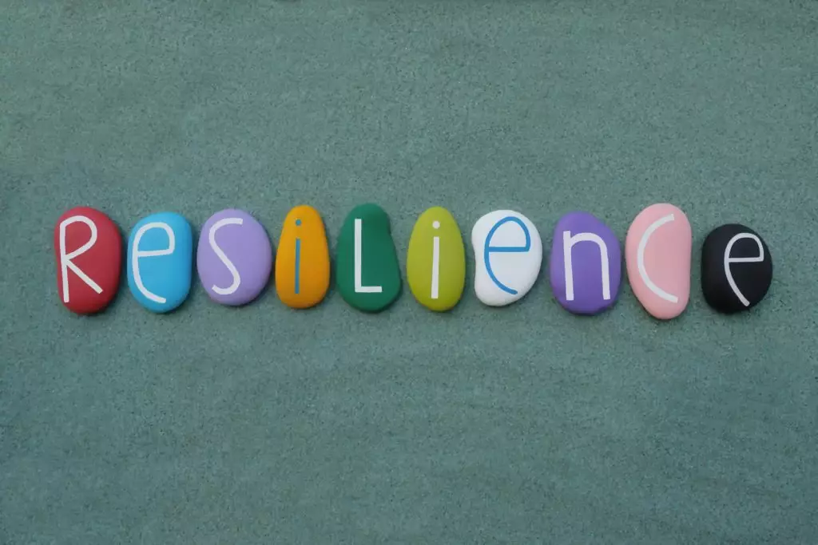
Comprehend the interplay between sustainability and resilience.
Resilience for tourism destinations refers to their ability to adapt, recover, and thrive in the face of disruptions, such as natural disasters or crises, while sustaining their appeal and infrastructure.
There is a need for a more resilient tourism industry to address current and future challenges

Slide 6
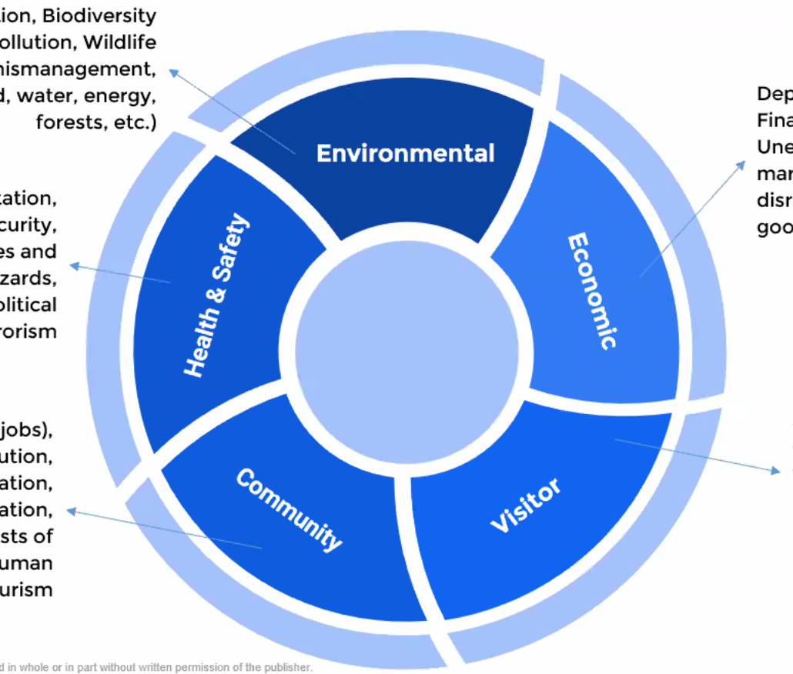
Comprehend the interplay between sustainability and resilience.
The 5 Areas of Resilience for Tourism Destinations
Climate Crisis, Pollution, Waste Management, Biodiversity loss
GDP relying on Tourism, Economic crisis, Seasonality, Supply chain disruptions, Economic Leakage
Unsafe Food and water, Bad Hygiene conditions, Pandemics, Political Instability, Terrorism
Inequalities (Income-Resources), Dependance on Tourism (Employment), Cultural Degradation, Overtourism
Insufficient Infrastructure , Old-fashioned management and IT systems, Negative Image (Social Media), Slow adaptation to new trends
PATA.org

Slide 7

Comprehend the interplay between sustainability and resilience.
Resilience is a Process, but it is also an Outcome
Allows Destinations to Cope with Challenges and Recover after a Crisis
Managing Crises
Risk Assessment
Risk Management
Adaptive Capacity

Slide 8

Comprehend the interplay between sustainability and resilience.
Adaptive Capacity
Strengthening Abilities– Organizations, Economy, Society
Developing Advanced Infrastructures
Priority in Local Supply and Demand
Diversification of Tourism Products and Services

Slide 9
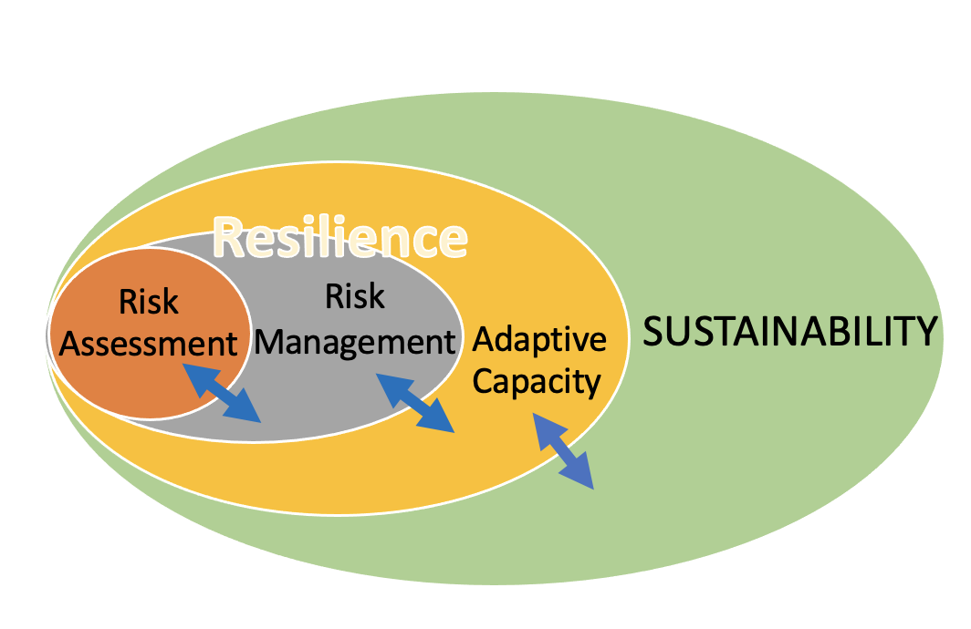
Comprehend the interplay between sustainability and resilience.
Risk Assessment
Risk Management
Adaptive Capacity
Sustainability
Sustainability is therefore not enough. Before a destination can be sustainable, it must first be resilient

Slide 10
Integrating resilience into business environments, including SMEs.
Small and medium-sized enterprises (SMEs) are crucially important to societies and economies around the world, accounting for 99% of all businesses and three-quarters of all jobs in those sectors most affected by the Covid-19 crisis across the Organisation for Economic Co-operation and Development (OECD) countries.

Slide 11
Integrating resilience into business environments, including SMEs.
Digital tools can help SMEs and entrepreneurs weather the storm in the short term and strengthen resilience to shocks in the longer-term.
Digital applications can offer immediate solutions to increasing cost pressures (e.g. energy bills), but also help SMEs strengthen their business model in the longer term;

Slide 12
Integrating resilience into business environments, including SMEs.
However, the digital transformation of SMEs cannot happen overnight, as, despite the recent acceleration, long-standing barriers remain. The lack of digital skills and of reliable internet connection continues to hinder or limit
the digital transition of SMEs across many destinations. Skills shortages weigh on SME recovery, on their capacity to adapt to a volatile business environment and embrace long term transformations.

Slide 13
Integrating resilience into business environments, including SMEs.
Furthermore the digital transition has the potential to facilitate SME sustainability, but trade-offs must be taken into account. The transition towards more sustainable economies and societies has become an ever more important objective for many destinations. SMEs play an important part in this transition, given the relatively large share of CO2 emissions they are responsible for but also their potential to develop and implement Eco-innovations and greener business practices.

Slide 14
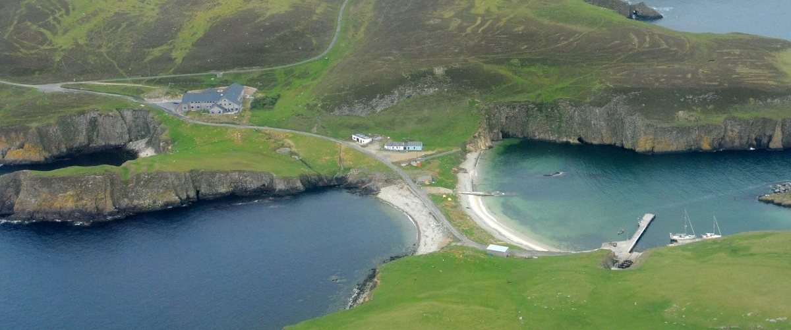
Explore the resilience of tourism destinations.
Resilience in the face of changing circumstances - Fair Isle, Shetland
While Fair Isle is far from being an independent state, the island’s Community Council have sought to refocus the community’s economic focus from what was essentially subsistence agriculture to a much more diverse set of goals, of which tourism is a major part. They are focused on improving amenities on the island rather than developing the economy, so the major improvements in housing quality and utilities have undoubtedly helped in establishing the population’s confidence and resilience.

Slide 15
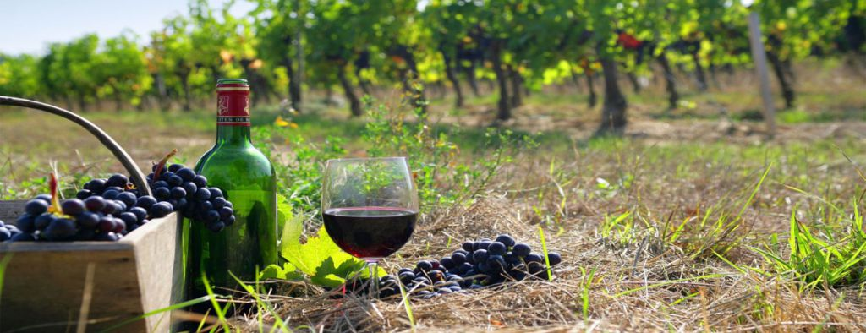
Explore the resilience of tourism destinations.
Threats and obstacles to resilience Insights from Greece’s wine tourism
There is evidence indicating implications for both policy makers and planners involved in the design of long-term wine tourism strategies. The conceptualization of shocks and stressors that affect the resilience of the Greek wine tourism system proposes a ‘roadmap’ towards the development of the sector in a sustainable manner. Wine tourism can become a catalyst for the wine producing value chain infusing quality infrastructure and experience-oriented frameworks.

Slide 16

Explore the resilience of tourism destinations.
The sustainability of small business resilience - The local tourism industry of Yogyakarta, Indonesia a decade after the crisis
Yogyakarta, with a population of half a million people has been described as the most popular tourist destination on Java due to its proximity to the temples of Borobudur and Prambanan.
Based on a study comprising ethnographic methods, the research reveals that local tourism businesses show remarkable resilience during a decade of crisis affecting the Indonesian tourism industry. This resilience has to be understood in terms of its embeddedness in a package of livelihood strategies.

Slide 17
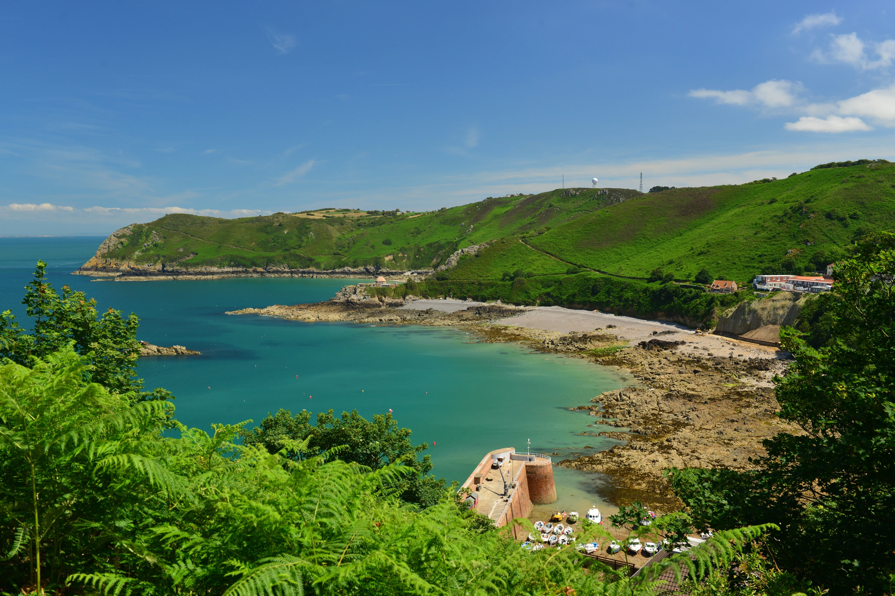
Explore the resilience of tourism destinations.
Tourism and resilience on Jersey. Culture, environment, and sea
Sustainability and resilience, in Jersey is based on cultural tourism, environmental tourism, and sea tourism, it has emerged that each contributes cultural capital for the island in terms of their importance for the tourism industry at a time when resilience has underpinned a re-thinking of the nature of this industry. At the same time as preserving cultural and environmental heritage as island capital, the sea has been utilized in a context of aiming to grow the tourism industry.

Slide 18
Discussion about Resilience in Mekong Region

Slide 19
Q & A
Thank You!

