Slide 1
Sustainable & Smart Tourism
Training Program
Organized by Mekong Institute (MI)
Funded by Mekong – Korea Cooperation Fund (MKCF)
November 2023

Slide 2
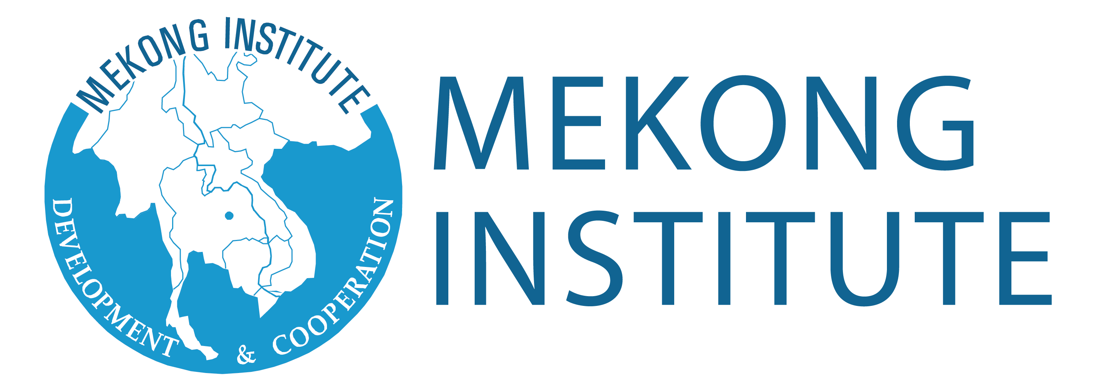
Developing Adaptive Capacities for Resilient Tourism Ecosystems.
MODULE 6
Trainer
November 2023

Slide 3
Challenges in Various Scales - The need for CHANGE
Session 2
Monday

Slide 4
Current and Future Challenges in Tourism
Proactivity in Governance and Businesses
Risk Assessment and Change Dynamics
Change Management

Slide 5
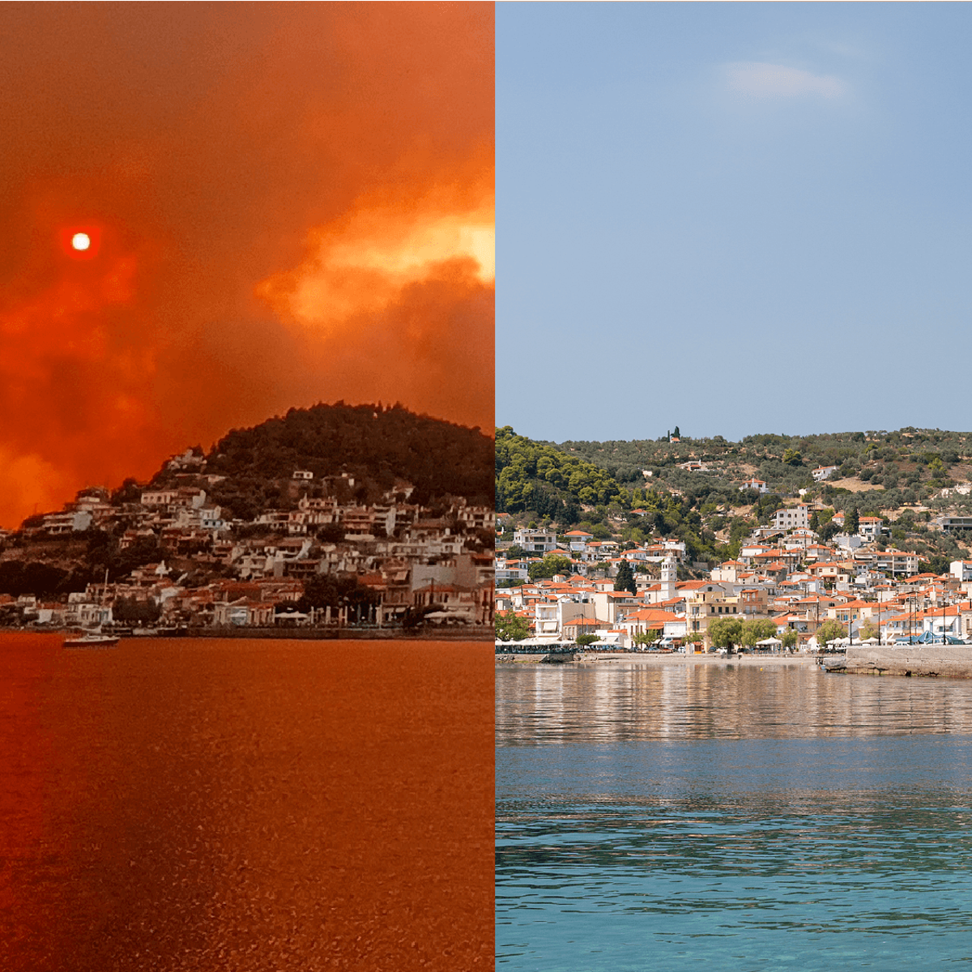
Current and Future Challenges in Tourism
Covid-19 disrupted most industries, but especially travel and tourism.
The pandemic has changed consumer behaviour in ways which are still playing out. There is the possibility of new variants causing short-notice border restrictions in the future.
Aside from Covid, international travel remains hampered by confusion, concern and unpredictability. Here, we look at the main challenges facing travel and tourism in a fast-changing world.

Slide 6
Current and Future Challenges in Tourism
Inflation and the rising costs of travel
Airfares are at record highs
Lodging prices – for hotels and motels etc. – are volatile
Car rentals have seen big increases – as of May 2022, prices were around 70% higher than in May 2019

Slide 7
Current and Future Challenges in Tourism
Short staffing affects ability to meet customer expectations
Many travel businesses laid off or lost staff during the pandemic – reportedly, a total of 62 million tourism-related jobs were lost worldwide in 2020. Now that leisure demand is building again, businesses have struggled to hire enough replacements. Short staffing explains the scenes of airport chaos we’ve seen, not just in the UK but around the world.

Slide 8
Current and Future Challenges in Tourism
Remote workers have created a new travel niche
The increase in remote working and digital nomads has created a new travel niche. With workers untethered from the office, they now have scope to work from other locations. These travellers have a particular set of attributes or requirements:
- Above average buying power
- Greater flexibility on travel dates
- A need for a quiet, comfortable space to work – perhaps away from crowded tourist areas
- Fast and reliable Wi-Fi
- Access to wellness-related amenities, such as gyms or healthy meals on the go
- The flexibility to reschedule leisure activities to accommodate work

Slide 9
Current and Future Challenges in Tourism
Consumers are increasingly concerned about sustainability
According to Sustainable Travel International, tourism is responsible for about 8% of the world’s carbon emissions. Businesses are under pressure from both consumers and governments to become more sustainable. The tourism industry faces the challenge of adding decarbonisation to its value proposition. In practice, this means re-examining what travel should look like and how sustainable practices can be incorporated. This will require collaboration across the whole industry.

Slide 10
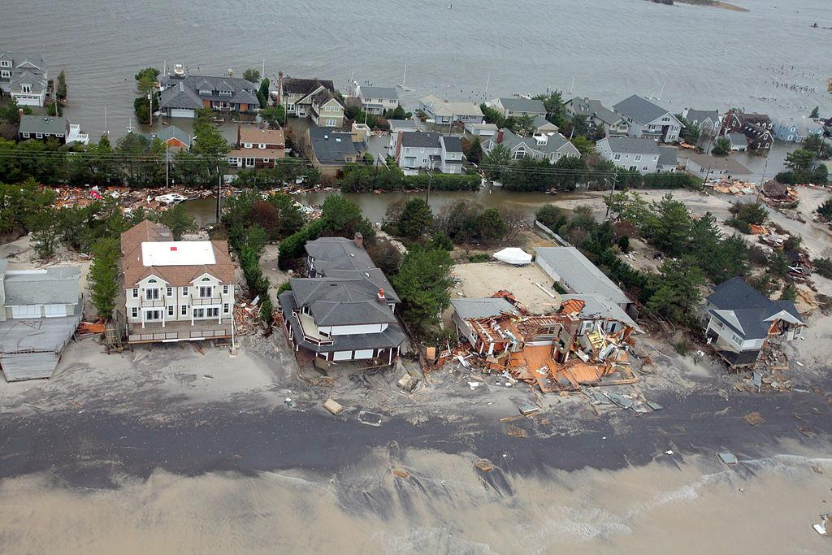
Current and Future Challenges in Tourism
Disasters – both man-made and natural – are an ever-present threat
As any tourism business knows – especially those with operations in major cities – security risks such as terrorist attacks or political unrest are a grim reality, alongside threats from natural disasters such as pandemics, tsunamis, earthquakes, floods, volcanoes, avalanches, mega fires and so on.

Slide 11
Proactivity in Governance and Businesses
In today's rapidly evolving business landscape, companies increasingly recognize the importance of Environmental, Social, and Governance (ESG) factors in their operations. Ethical considerations and the potential for financial benefits and risk mitigation drive the proactive adoption of a corporate ESG agenda.

Slide 12
Proactivity in Governance and Businesses
Proactive public services should be the norm. Importantly, proactive provision requires a joined-up approach, breaking apart siloes between organizations and departments as they pool together data. This means reimagining the function and design of state institutions not building digital channels for analogue services.

Slide 13
Risk Assessment and Change Dynamics
Tourism risk management process is concerned with identifying
and analysing the risks (‘the chance of something happening that will have an impact upon objectives’) to a destination or organisation and deciding what can and should be done about them. They are logical and systematic problem-solving and decision making processes.
The tourism industry should be involved in both crisis management (the
organisational process) and disaster management (the multi-agency, community-based process).

Slide 14
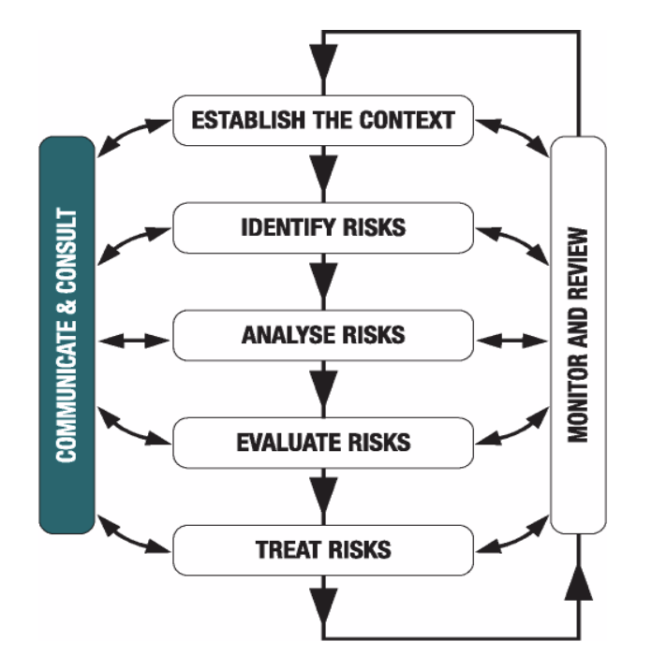
Risk Assessment and Change Dynamics
Tourism risk management process steps.
- Establish the Context
- Identify Risks
- Analyse Risks
- Evaluate Risks
- Treat Risks

Slide 15
Risk Assessment and Change Dynamics
Tourism needs to adopt to become resilient. This needs CHANGEs in various levels and in different extend. The CHANGE is always including minor or bigger risks. It can create turbulences and therefore Risk Management is also contributing to CHANGE MANAGEMENT

Slide 16
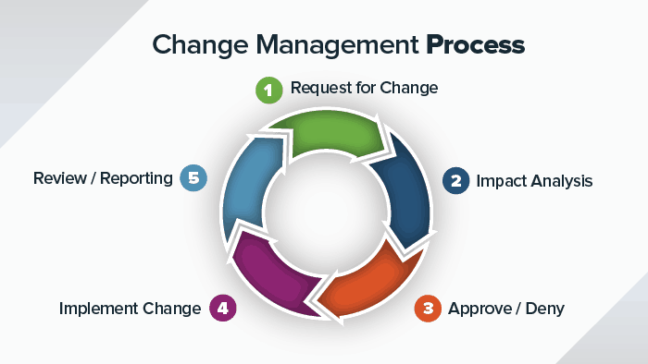
Change Management
Change management is a systematic approach to dealing with the transition or transformation of an organization's goals, processes or technologies.
The purpose of change management is to implement strategies for effecting change, controlling change and helping people to adapt to change.

Slide 17
Change Management
Transformation & Change Leadership
Transformational leaders manage by establishing a relationship with employees and building a common “vision” for change. Change leaders, on the other hand, focus on the specific change occurring and how to effectively implement the Change
CHANGE can be small and incremental, or it can be large and complex. But it is something that needs to be constantly monitored and maintained.
TRANSFORMATION is almost always large and significant. Transformation is an internal fundamental evolution of your beliefs of why you perform certain actions. Transformation may not require any external influence to maintain, but it does require foundational shifts from within.

Slide 18
Discussion about Challenges in Mekong Region

Slide 19
Q & A Thank You!

