Slide 1
Sustainable & Smart Tourism
Training Program
Organized by Mekong Institute (MI)
Funded by Mekong – Korea Cooperation Fund (MKCF)
November 2023

Slide 2



Developing Adaptive Capacities for Resilient Tourism Ecosystems.
MODULE 6
Trainer
November 2023

Slide 3
Sustainable Tourism Strategy and Planning based on Smart and Digital resources
Session 4
Monday

Slide 4
Smart Applications for Sustainable Tourism
Presenting the MEKONG-HERITAGE Digital Platform
Analyzing the functions of the Application
Practicing the use of the Applications
Exploring the benefits from the Application in the framework of Smart & Sustainable Tourism

Slide 5
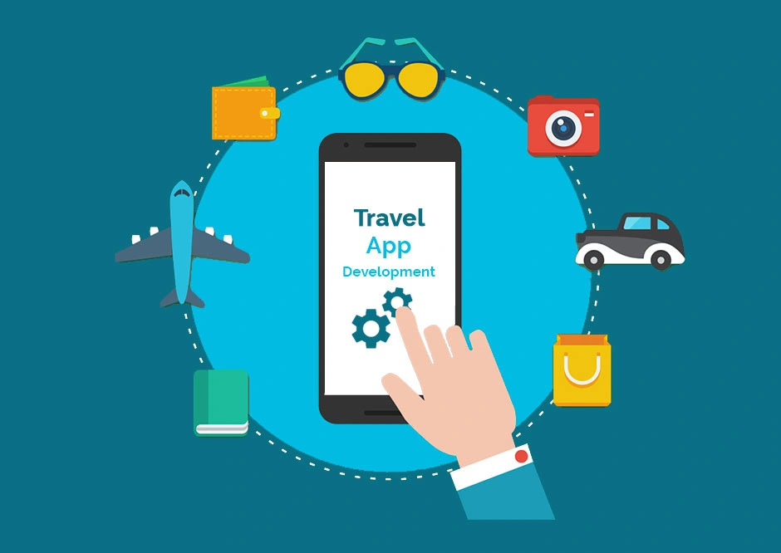
Smart Applications for Sustainable Tourism
Travellers use travel apps as a medium for online ticketing, hotel booking, getting destination details, locating local attractions and food outlets; exploring new destinations; finding reviews about a destination they plan to visit; sharing pictures from their travel; posting feedback on a destination, airline, hotel etc.
It is something that we all familiar to use but there are deferent levels on sustainability values.

Slide 6
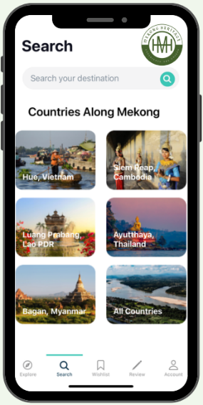
Presenting the MEKONG-HERITAGE Digital Platform
Heritage is a valuable resource for almost all destinations. In many cases places with long history and strong heritage can benefit a lot highlighting important and attractive elements that actually are part of the place DNA and they are shaping the destination’s BRAND.
So Mekong Region is maximizing the heritage values for the benefit of the visitors but also the local communities

Slide 7
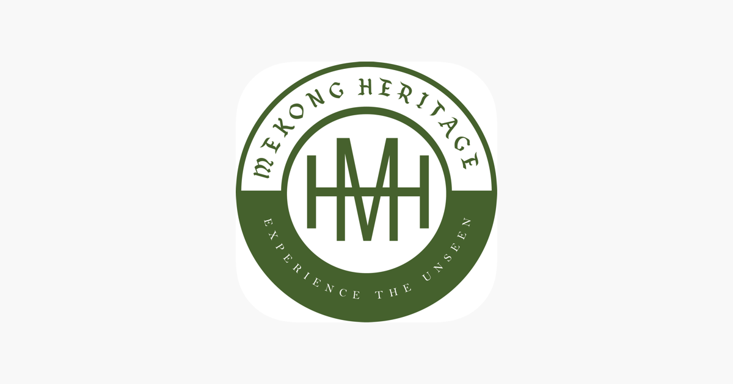
Presenting the MEKONG-HERITAGE Digital Platform
The applications introduces the unique traditions and historical significance of the vibrant communities in the Mekong region.
Explores key attractions, tourism services, and local products in Ayutthaya of Thailand, Bagan of Myanmar, Hue of Vietnam, Luang Prabang of Laos, and Siem Reap of Cambodia, with a user-friendly interface.
Emerges diverse heritage sites and their fascinating stories, connecting visitors to the rich past and with a global community dedicated to preserving and celebrating the Mekong's cultural legacy.

Slide 8



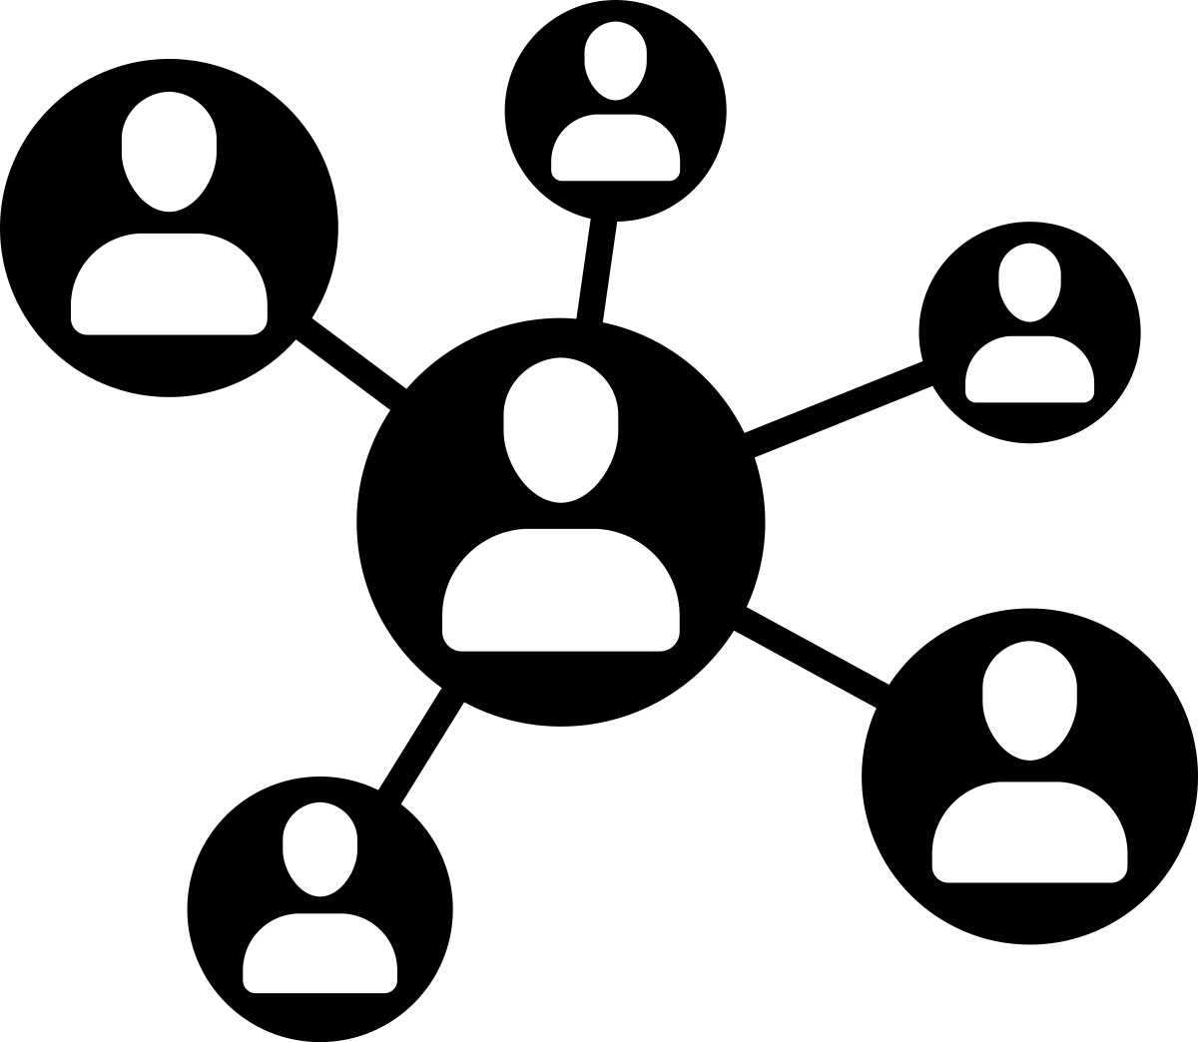

MEK NG HERITAGE
Digital Platform
Analyzing the functions of the Application
Explore
Share
Experience
Save Places
wish list
SUSTAINABLE AND SMART TOURISM DEVELOPMENT
IN MEKONG REGION
Supported by Mekong-Republic of Korea Cooperation Fund (MKCF)

Slide 9

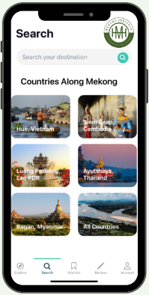





AB O UT
Analyzing the functions of the Application
Designed to provide comprehensive information on
key attractions,
tourism services, and
products of the five project locations within the Mekong Region.
Serves as a valuable resource for both local residents and tourists through offering a user-friendly interface that allows easy access to a wealth of cultural information and travel resources.
By utilizing the app, users can gain insights into the diverse heritage sites, explore their historical significance, and discover the fascinating stories behind them.
Main purpose of the App
Demand side: To provide updated information for the international travelers who are willing to visit to 5 Mekong heritage sites, To maximize travel experiences visiting the heritage destinations.
Supply side: To help SMEs approach international travelers, to help tourism operators to increase their visibility to travelers while gaining valuable customers’ analytical data and market insights that will help them to make better data-driven business decisions for innovation.

Slide 10
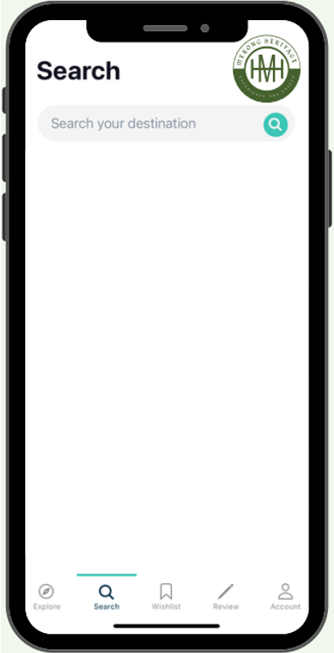

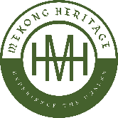
For Whom
Tourism promotion agencies
Private tour and travel operators
Tourism enterprises
- Hotels
- Restaurants
- Entertainment centres
- Souvenir shops
- Local crafts, and etc.
Creative artists/performers
Worldwide Travelers
Investors
Tour guides
Tourism media/ social media influencers
Universities/hospitality education
Training centres among others.
Analyzing the functions of the Application
Source: www.vectorstock.com/23456486

Slide 11
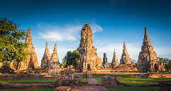
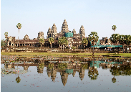
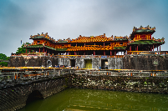
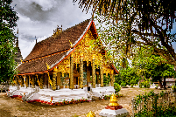

























Main Categories – 1,153 POIs
1991 1992 1993 1995 2019
POIs [127] [478] [168] [226] [154]
Main Functions
Google Play
App Store
Heritage Attractions
Explore
Unique feature
Multimedia content
Interactive map
Contact
Personalized REC
Info addable
Accommodations
Share
Experience
Save Places
Restaurants
wish list
Others

Slide 12
Exploring the benefits from the Application in the framework of Smart & Sustainable Tourism
A big variety of benefits from a single smart applications. Benefits that are contribute to the sustainability of the region in a very efficient and SMART way

Slide 13





BENEFiTS
Convenience
Information Updates
Personalization
Review and Rating
Navigation
Booking and Reservations
Cost Saving
Travel itineraries
Heritage and Local Insights
Safety Features
Environmental Impact
Feedback and Support
Memory Keeping
Marketing Channel
Etc.

Slide 14
MEK NG HERITAGE
Digital Platform
Practicing the use of the Applications
Explore
Share
Experience
Save Places
wish list
SUSTAINABLE AND SMART TOURISM DEVELOPMENT
IN MEKONG REGION
Supported by Mekong-Republic of Korea Cooperation Fund (MKCF)

Slide 15
Discussion about the use of the Application

Slide 16
Q & A
Thank You!

