Slide 1
Sustainable & Smart Tourism
Training Program
Organized by Mekong Institute (MI)
Funded by Mekong – Korea Cooperation Fund (MKCF)
November 2023

Slide 2



Understanding the Tourism Value Chain and the Tourism Ecosystem through System Thinking
MODULE 1
Trainer
November 2023

Slide 3
Tourism System & System Thinking
Session 5
Monday

Slide 4
The Complexity of Tourism
Translating System Thinking into Tourism
Global vs Local Tourism Systems
The Glocal Tourism Systems Approach

Slide 5


The Complexity of Tourism
Tourism Functions as a Complex System, where the parts contribute to the whole, but the whole is far greater then the sum of the parts.

Slide 6

Tourism as a System
To be complete, a System must possess
An Environment – System’s Location
Units – System’s Parts
Relationships – How the parts interact
Atributes – The Quality of the Units
Inputs, Outputs & Feedback
A Model

Slide 7


System Thinking & Tourism
Inputs – Multiple Interactions - Outcomes

Slide 8

Tourism as a System
Tourism Functions
Supply
Demand
Socio-cultural Environment
Natural Environment
Governance

Slide 9


Global vs Local Tourism Systems
Global Networks and Local Identities

Slide 10

Global vs Local Tourism Systems
Global vs Local
Global Dynamics difficult to Control
Local Characteristics are allienated
Global Metworking can Help IF!!
Localization improves Competitivenes
Balanced Combination - GLOCALization

Slide 11


Global vs Local Tourism Systems
Thing Big – Holistic Approach

Slide 12


Global vs Local Tourism Systems
Emphasize Local Identity – Reflect on Global Scale

Slide 13

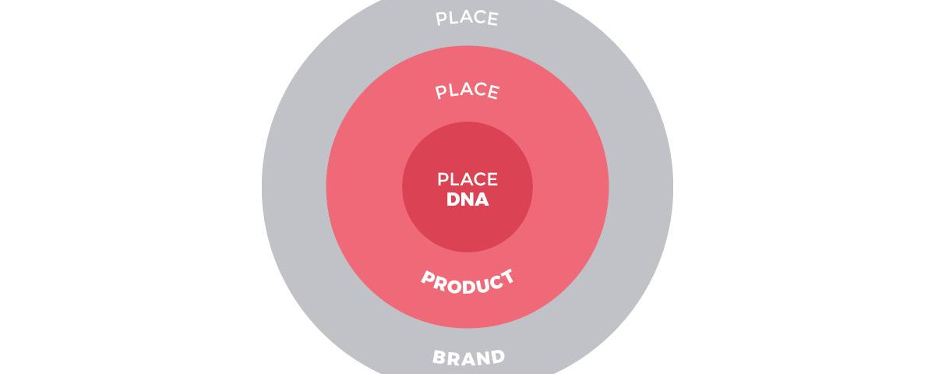
Global vs Local Tourism Systems
Use the Global Dynamics – Infuse Place DNA

Slide 14


The GloCAL Tourism System Approach
Local Sustainable Tourism Initiatives – Global Systems Exposure

Slide 15
The GloCAL Tourism System Approach
Local Social Voices on a Global Scale

Slide 16
Q & A
Thank You!

