Slide 1
Sustainable & Smart Tourism
Training Program
Organized by Mekong Institute (MI)
Funded by Mekong – Korea Cooperation Fund (MKCF)
November 2023

Slide 2



Introduction of Sustainable Tourism and the Need for a Regenerative Approach
MODULE 2
Trainer
November 2023

Slide 3
Introducing Sustainable Tourism (2)
Session 2
Tuesday

Slide 4
Sociocultural, Environmental & Economic Sustainability
Integrating Sustainability into Local and Regional Tourism Ecosystems
Innovation & Creativity as Catalysts for Sustainable Tourism

Slide 5
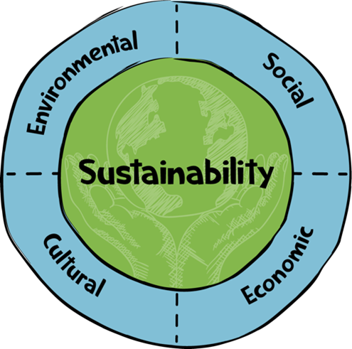
Sociocultural, Environmental & Economic Sustainability
A proper balance among Environmental, Sociocultural and Economic dimension of the destination can support a sustainable development

Slide 6

Sociocultural, Environmental & Economic Sustainability
What is Social Sustainability?
Social sustainability is about making sure that communities and societies can thrive and continue to exist in a healthy, fair, and equal way. It focuses on improving people's quality of life, fostering strong relationships, and ensuring everyone has the chance to fulfill their potential.

Slide 7
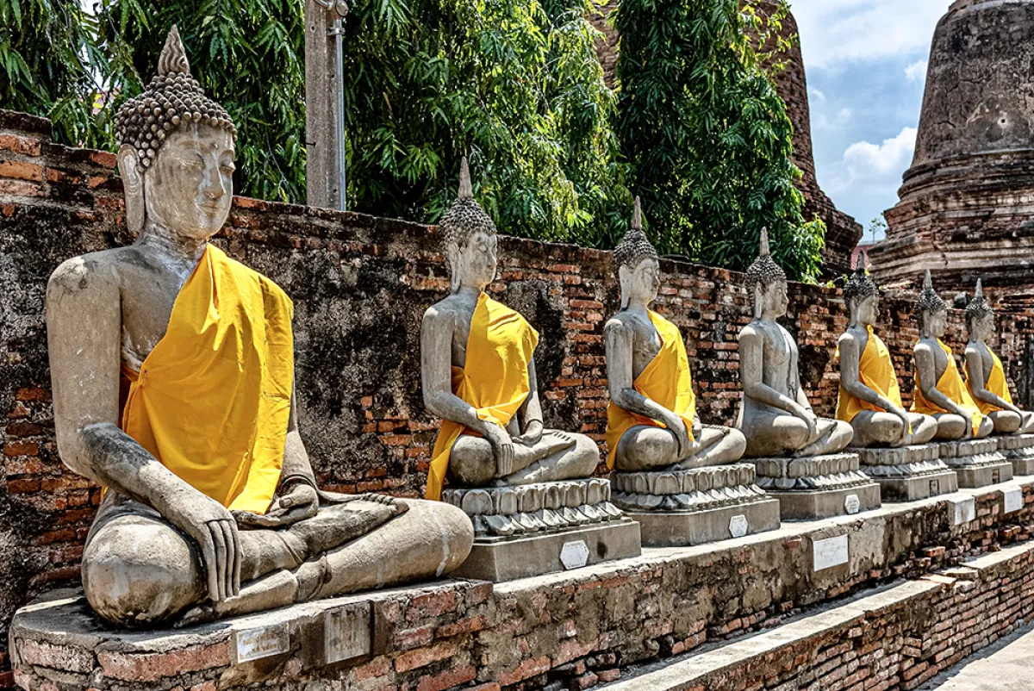
Sociocultural, Environmental & Economic Sustainability
What Is Cultural Sustainability?
Cultural Sustainability is the idea of protecting and sustaining the world’s cultural heritage. It is about ensuring that future generations can enjoy the same cultural experiences and traditions that we enjoy today.
s

Slide 8

Sociocultural, Environmental & Economic Sustainability
What is Environmental Sustainability?
Environmental sustainability means preserving natural resources so that future generations can enjoy the benefits they bring. Much of environmental sustainability involves balancing the extent to which natural resources are used compared to their availability. If society consistently consumes natural resources at a faster rate than nature can replenish them, this is unsustainable.

Slide 9

Sociocultural, Environmental & Economic Sustainability
What is Economic Sustainability?
Economic sustainability refers to practices that support long-term economic growth without negatively impacting social, environmental, and cultural aspects of the community.

Slide 10

Integrating Sustainability into Local and Regional Tourism Ecosystems
Integration
For each destination a different process but with similar goals is implemented. The outcome reflects a customized way of embedding sustainability into the local or regional

Slide 11

Integrating Sustainability into Local and Regional Tourism Ecosystems
The Case of Byron Bay (NZ)
Sustainable Streets program in Byron Bay
In each participating neighborhood, residents get together for sustainability workshops and build bonds in the neighborhood, whilst raising points to fund their own local sustainability project!

Slide 12
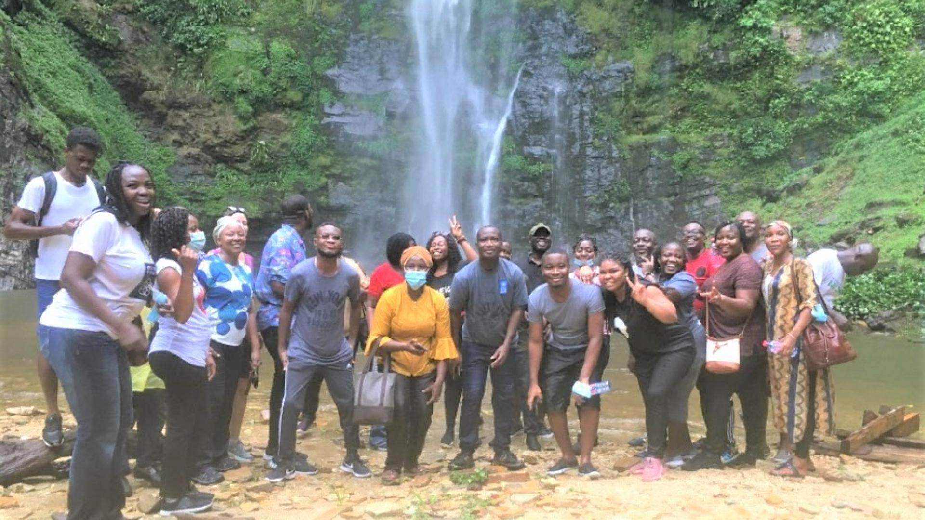
Integrating Sustainability into Local and Regional Tourism Ecosystems
Ghana: Community based tourism initiative
A project that has created new tourism products based on sustainability principles at the local community level, transforming the country’s tourism offer and revealing challenges for government support structures

Slide 13
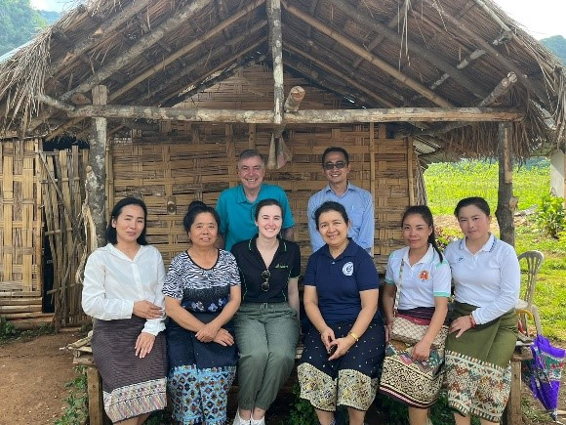
Integrating Sustainability into Local and Regional Tourism Ecosystems
Lao PDR – Collaboration Case
Inclusive and strategic basin planning in Lao PDR
the Government of Lao PDR is undertaking an ambitious program to develop river basin plans for all major basins in the country. River basin planning seeks to understand and manage the different needs and interests of the many water users in a basin. It seeks to reach agreement on basin governance arrangements and action plans to support economic and social development, whilst enabling environmental sustainability.

Slide 14

Innovation and Creativity as Catalysts for Sustainable Tourism
The Transformative Power of Innovation
The tourism sector is currently evolving from a mainly logistical industry towards a sector that is driven by technology and innovation. Many developing countries and emerging economies are currently leapfrogging ahead with highly innovative product approaches that can contribute efficiently to Sustainable Development

Slide 15
Innovation and Creativity as Catalysts for Sustainable Tourism
The Transformative Power of Innovation
In the quest for sustainable innovation, we’re seeking a new process, product or service, that adds value to a market and makes a positive impact on the environment and society.

Slide 16
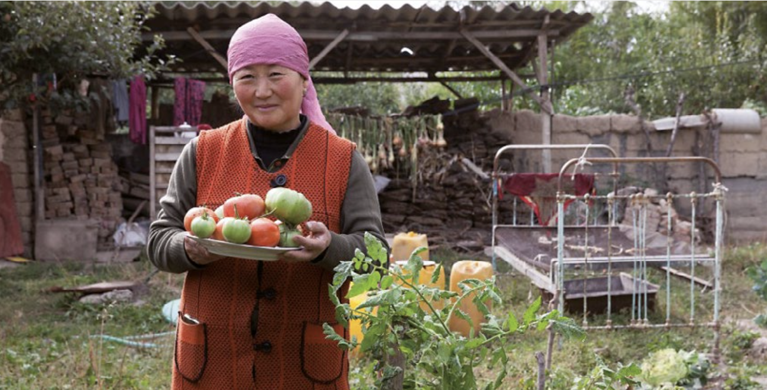
Innovation and Creativity as Catalysts for Sustainable Tourism
Creative Problem-Solving for Sustainability
Creating new source of income for Farmers in Kyrgyzstan
Promoting Sustainable Economic Development in Kyrgyzstan focused on promoting farms and their services . The development of agrotourism services was identified as a suitable solution for achieving the set objectives . Agrotourism combines rural tourism with agricultural offerings and addresses an environmentally aware group of individuals who enjoy nature .

Slide 17
Discussion about Innovative and Creative Ideas for Mekong Region

Slide 18
Q & A
Thank You!

